Slide 1
Math Memes
PUSD Math Talks

Slide 2
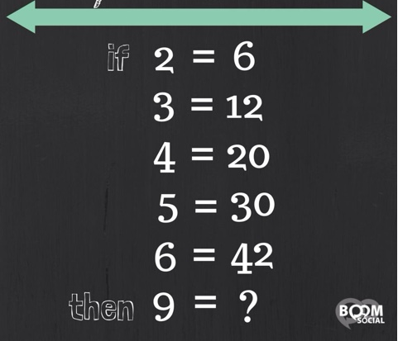
Notes:
Answer: ? = 90 [9 x 10 = 90; rule: n(n+ 1)]

Slide 3
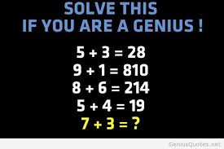
Notes:
Answer: 410 [first digit = 7 – 3, second digits = 7 + 3]

Slide 4
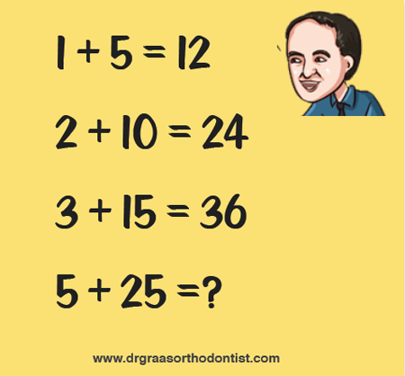
Notes:
Answer: 60 [2(5 + 25) = 60; rule 2(x + y)]

Slide 5
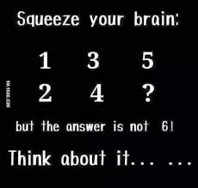
Notes:
Answer:

Slide 6
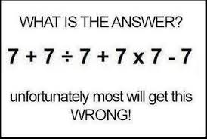
Notes:
Answer: 50

Slide 7
Notes:
Answer: 12

Slide 8
Notes:
Answer: 13

Slide 9
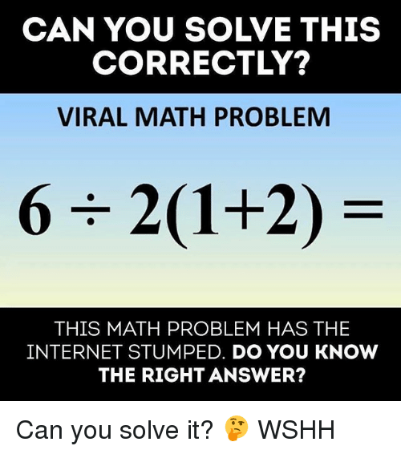
Notes:
Answer: 9

Slide 10
Notes:
Answer: 1

Slide 11
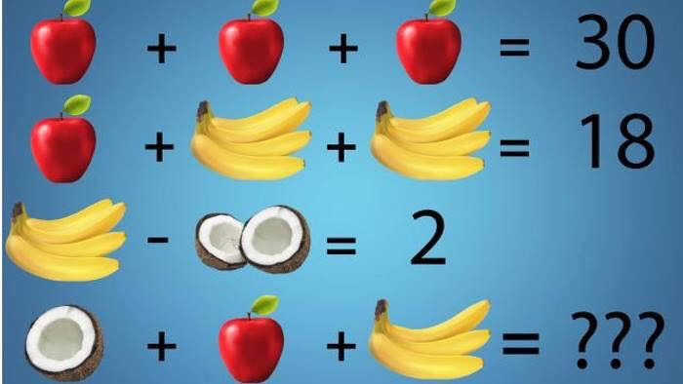
Notes:
Answer: Apple = 10, Single Banana = 1, ½ coconut = 1, therefore ??? = 1 + 10 + 3 = 14

Slide 12
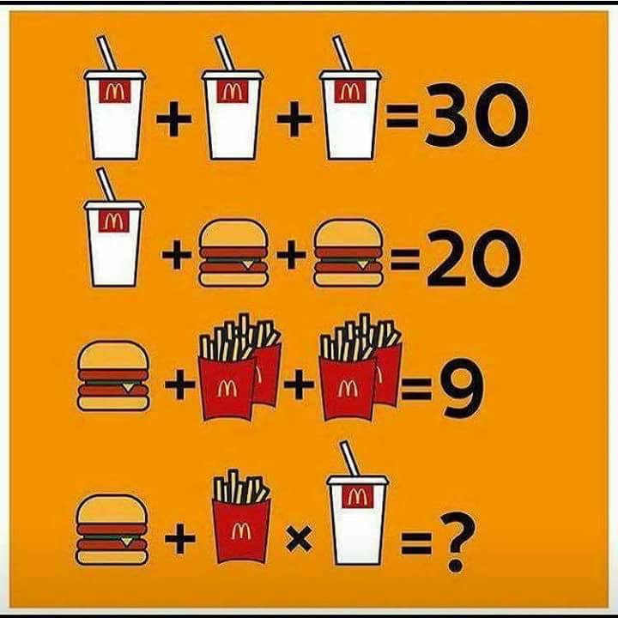
Notes:
Answer: Soda = 10, Burger= 5, fries = 1, therefore ? = 5 + 1 x 10 = 15

Slide 13
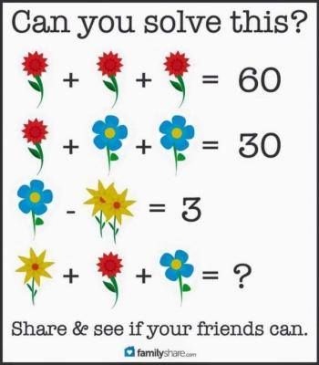
Notes:
Answer: Red = 20, Blue= 5, Yellow = 1, therefore ? = 1+ 5 + 20 = 26

Slide 14
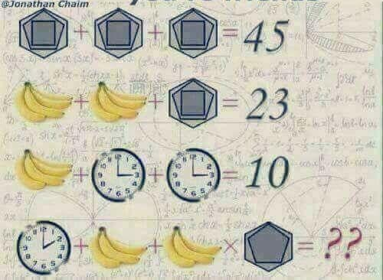
Notes:
Answer: Shapes = # of total sides, Single Banana = 1, clock = hour shown, therefore ?? = 2 + 3 + 3 + 11 = 19

Slide 15
Notes:
Answer: 87 (visual is upside down, going right to left, it goes 86, 87, 88…91)

Slide 16
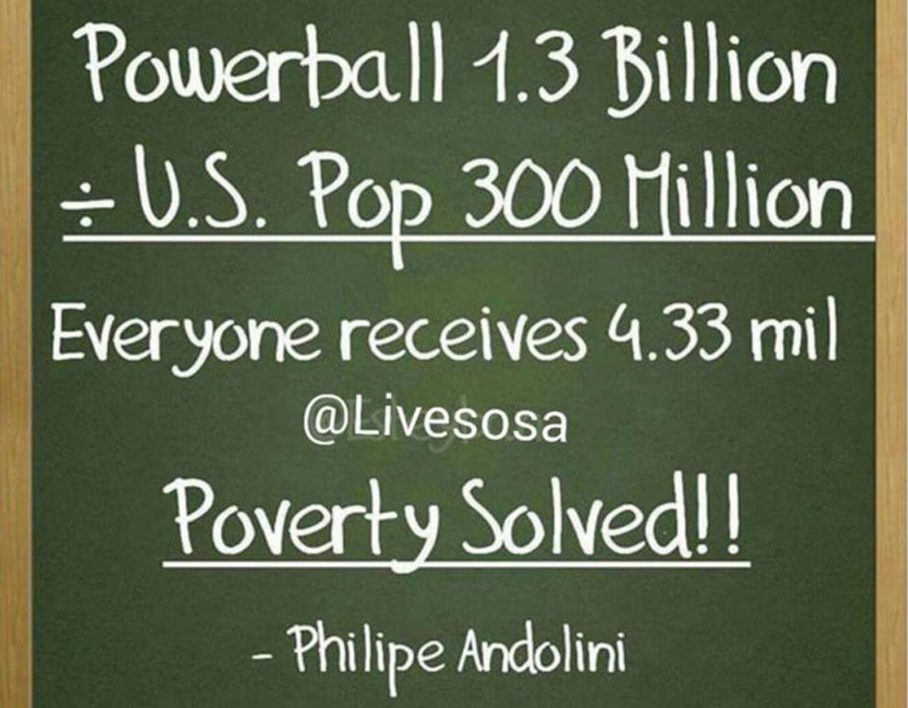
Notes:
Answer: Everyone received $4.33

Slide 17
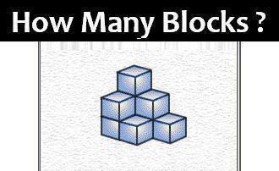
Notes:
Answer: 9 blocks

Slide 18
Notes:
Answer: Cannot be true. If a =b (line 1), then a – b = 0 (line 6). At line 6, it essentially, it reads 2(0) = 0, and you cannot divide a number by 0. Therefore, 2 does not equal 1.

Slide 19
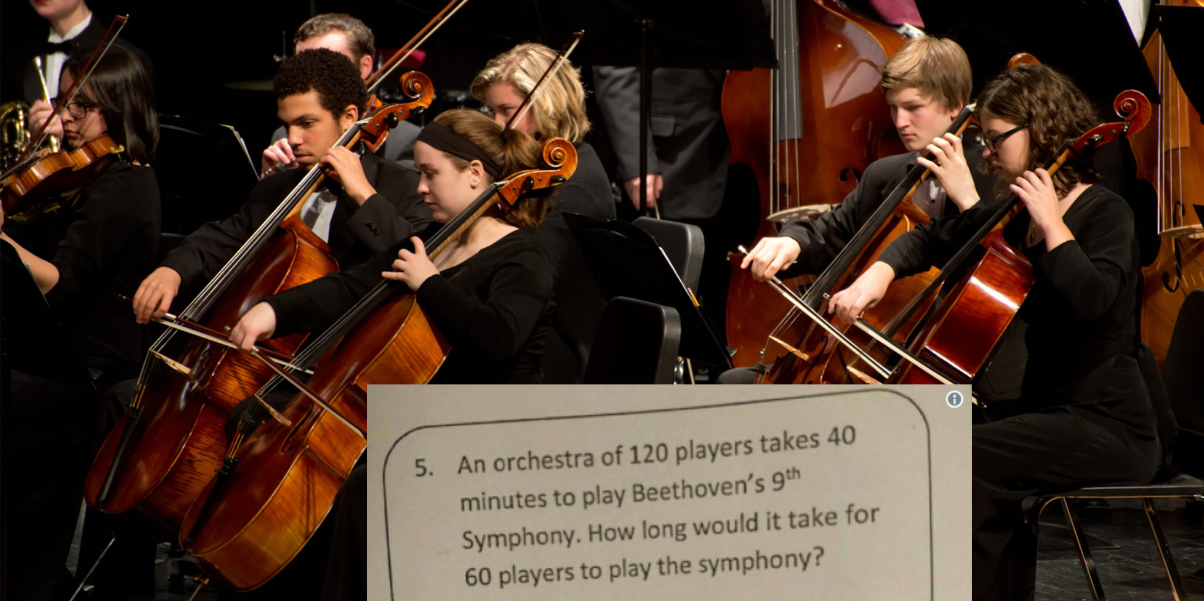
Notes:
Answer: no matter how many players are in the orchestra, it will take the same amount of time to play the song.

