Slide 1


Pittsburg Unified School District
Diving Deeper into Aligning the IEP, the Common Core State Standards
and Universal Design for Learning
October 13th, 2014
Kevin Schaefer
Assistant Director of Special Programs
WestEd Center for Prevention and Early Intervention
kschaef@wested.org

Slide 2

Outcomes
Participants will become familiar with and be able to integrate the principles of Universal Design for Learning and their relationship to lesson design, instruction, and IEP development
Participants will understand the “bigger picture” initiatives affecting special education and the importance of alignment
Participants will increase knowledge of the integrated literacy structure of the ELA CCSS for use in lesson design, instruction, and IEP development

Slide 3
Outcomes
Participants will strengthen their ability to develop IEPs based on the CCSS that result in educational benefit
Participants will identify the characteristics of a student who is prepared for college and career success as defined by the CCSS, ELA College and Career Anchor Standards, Mathematical Practices, Smarter Balanced, and the National Center and State Collaborative
Participants will create reasonably calculated IEPs that focus on independence, self-determination, problem-solving skills, etc. that are based on a student’s strengths, interests, preferences

Slide 4

Diving Deeper
Sue Austin: Deep Sea Diving…In A Wheelchair

Slide 5

A Synchronized Support

Slide 6

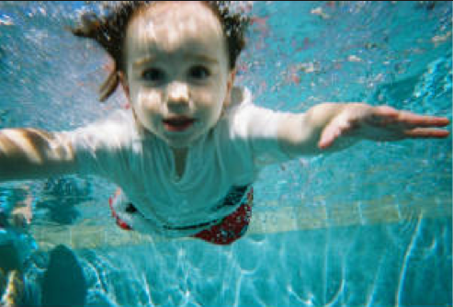
Dog Paddle, Freestyle, Backstroke, Breast Stroke, Butterfly

Slide 7
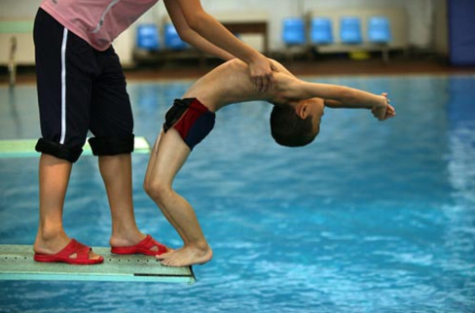
Getting Started

Slide 8
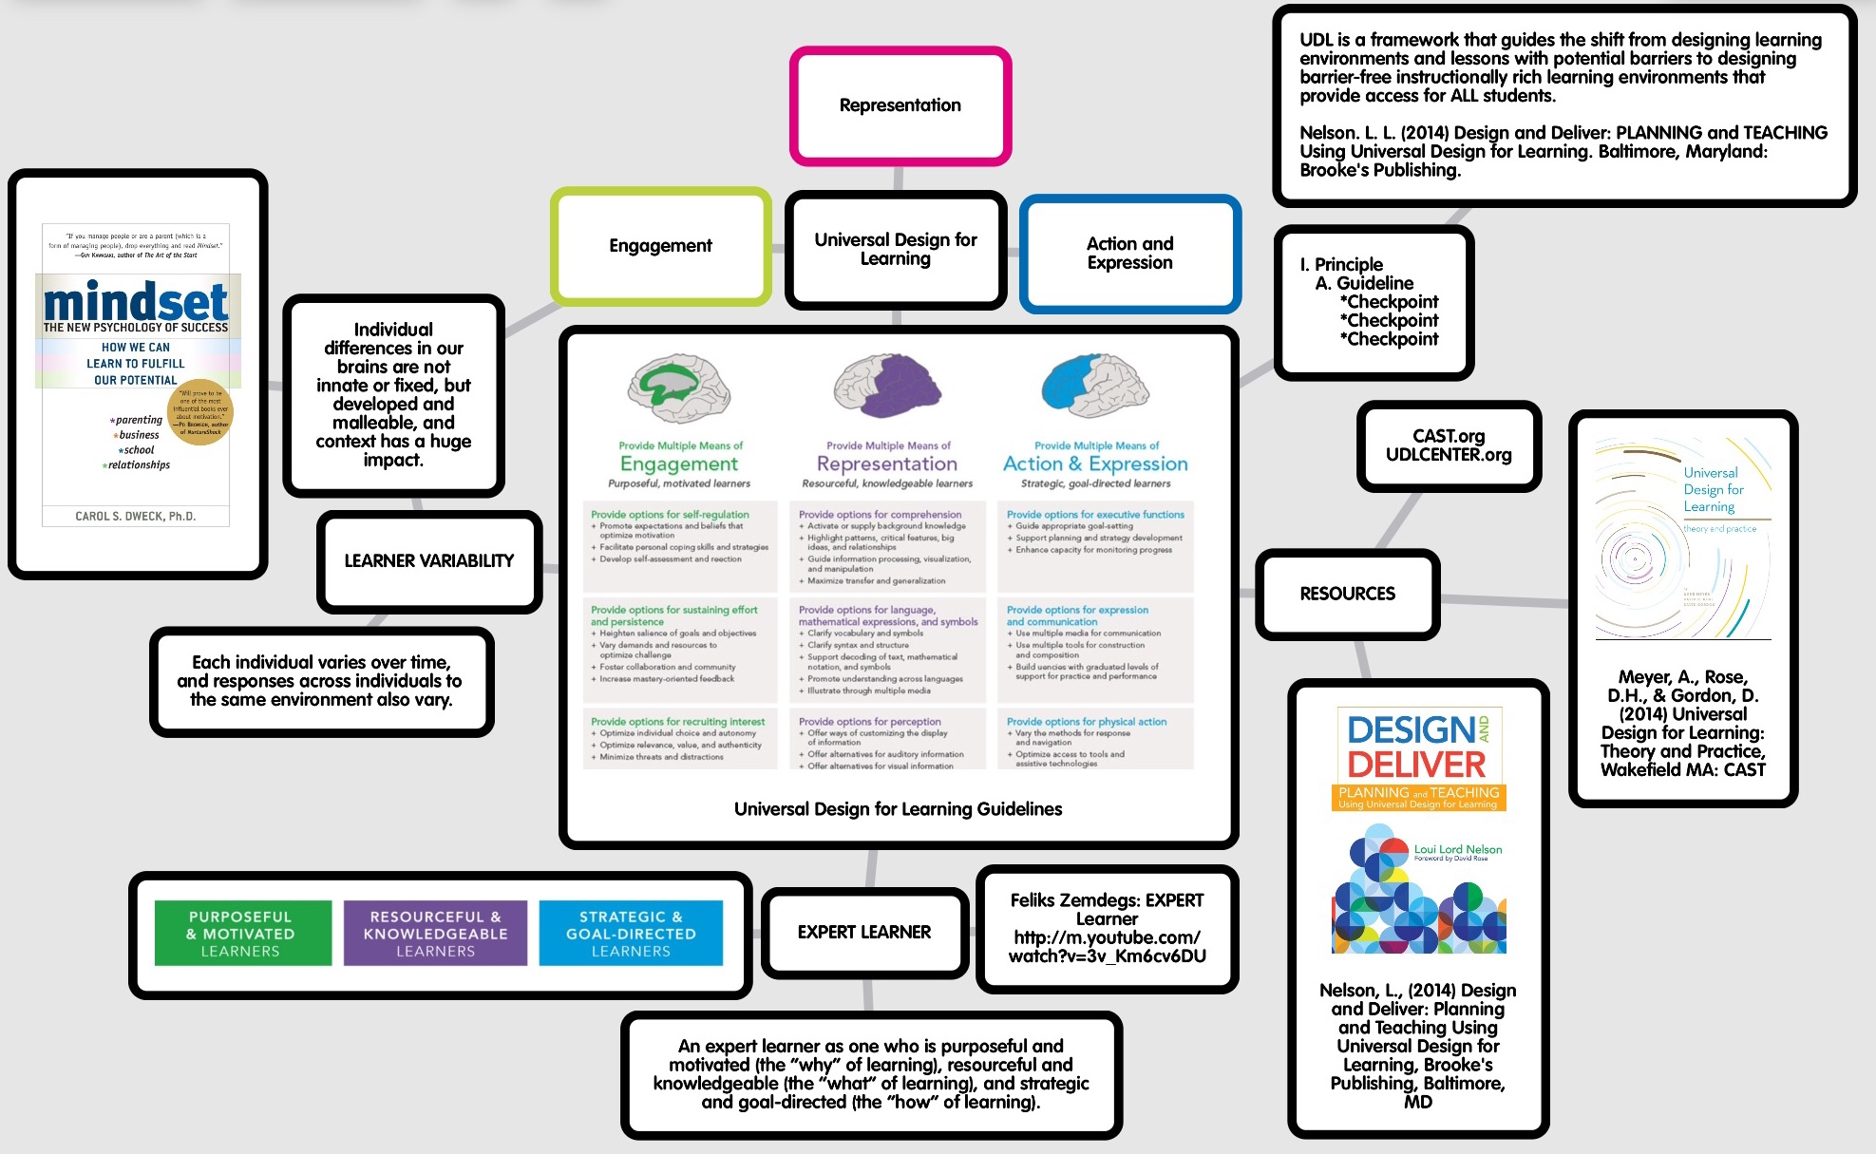
UDL Agenda
http://popplet.com/
Notes:
The UDL Agenda was created using a “Popplet” app, which is a free downloadable Mind Mapping tool. It addresses all three UDL principles as it is 1. Engaging; 2. Allows teachers to represent information to students in a way that connects what they are about to learn; and, 3. When used as an option for students to strategically express their understanding, it addresses Action and Expression (Principle #3).
To cut down on visual overload, go out of presentation mode, enlarge the graphic and describe each section one at a time or project your iPad screen which makes it easier to navigate.
Note the 3 Principles and the color coding used and reference the updated guidelines with the brains at the top
The definition of UDL
The structure/vocabulary of UDL (reference the guidelines as a visual support)
The resources: UDL Theory to Practice is an eBook. Access to the book is addressed in slide #8
Design and Deliver was just released and explores the checkpoints in depth for deeper understanding
UDL uses the term “Expert Learner” to describe learning as a process, not destination. A video, definition and how an expert learner is defined by UDL. This UDL graphic should be made as a color graphic which provides specific descriptions within the context of each principle (See slide #11)
Learner variability is defined, how learners abilities can be based on the context in which they are learning and Mindsets, the work by Carol Dweck is a resource. (Slide #13 and #14)

Slide 9
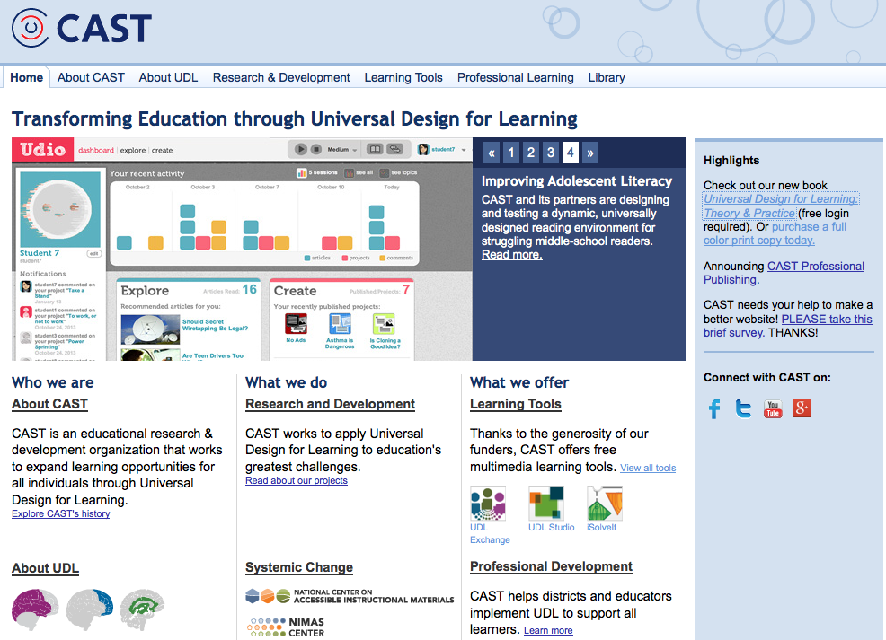
www.CAST.org

Slide 10
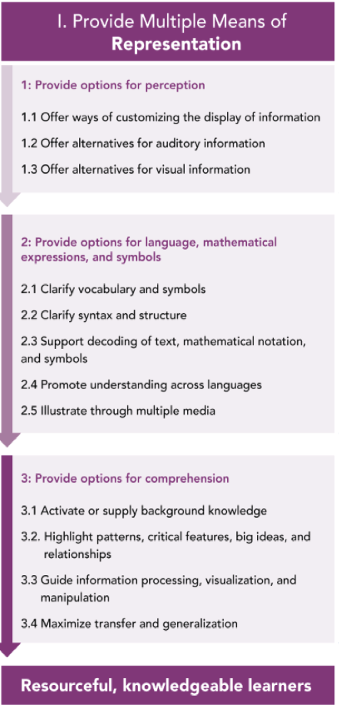
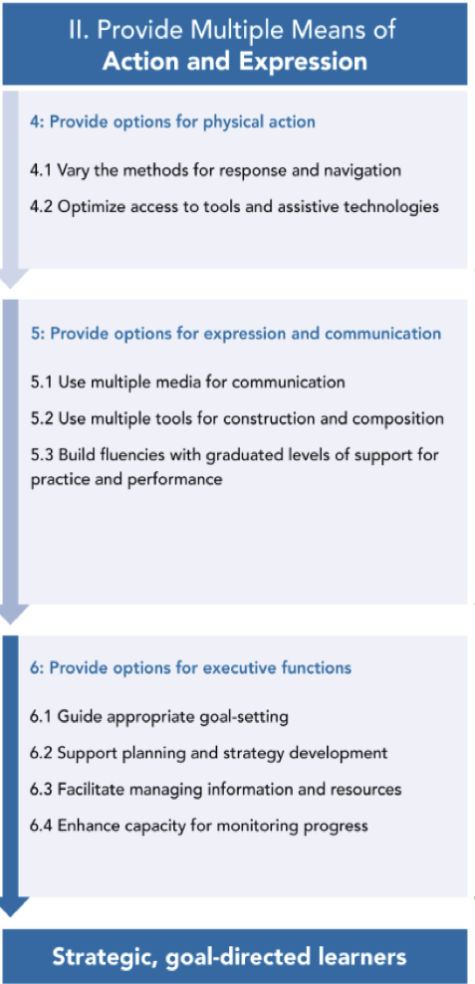
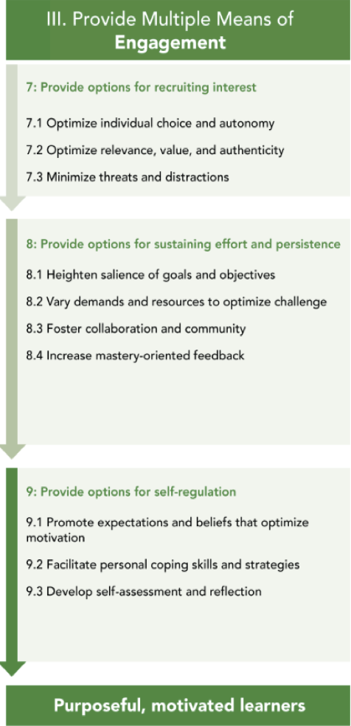
OUTDATED
Notes:
As participants research, they may notice there are various representations of the UDL Guidelines. This slide moves to realign the principles based on the updated guidelines. In the end, they should always reference the color coding which has not changed.

Slide 11
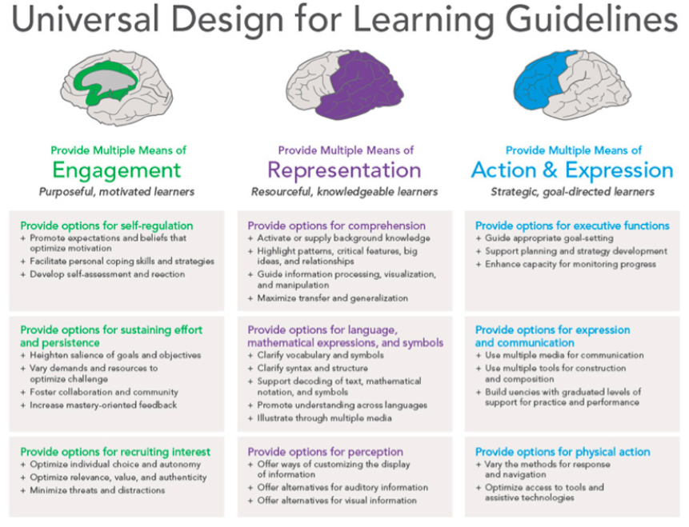
UPDATED
Notes:
Q 1: What is Universal Design for Learning?
Universal Design for Learning (UDL) is a research-based framework for designing curricula—that is, educational goals, methods, materials, and assessments—that enable all individuals to gain knowledge, skills, and enthusiasm for learning. This is accomplished by simultaneously providing rich supports for learning and reducing barriers to the curriculum, while maintaining high achievement standards for all students.
Q 2: How does Universal Design for Learning help teachers in real classrooms?
From pre-kindergarten to graduate school, classrooms usually include learners with diverse abilities and backgrounds, including students with physical, sensory, and learning disabilities, differing cultural and linguistic backgrounds, varied preferences and motivations for learning, students who are unusually gifted, and many others.
Universal Design for Learning supports teachers’ efforts to meet the challenge of diversity by providing flexible instructional materials, techniques, and strategies that help teachers differentiate instruction to meet these varied needs. It does this by providing options for:
Presenting information and content in different ways (the "what" of learning)
Differentiating the ways that students can express what they know (the "how" of learning)
Stimulating interest and motivation for learning (the "why" of learning)
A universally designed curriculum is designed from the outset to meet the needs of the greatest number of users, making costly, time-consuming, and after-the-fact changes to curriculum unnecessary.
Q 3: How does UDL help guarantee students equal opportunities to learn?
Both IDEA and NCLB recognize the right of all learners to a high-quality standards-based education. The laws preclude the development of separate educational agendas for students with disabilities and others with special needs. They also hold teachers, schools, districts, and states responsible for ensuring that these students demonstrate progress according to the same standards.
Neither law adequately addresses the greatest impediment to their implementation: the curriculum itself. In most classrooms, the curriculum is disabled. It is disabled because its main components—the goals, materials, methods, and assessments—are too rigid and inflexible to meet the needs of diverse learners, especially those with disabilities. Most of the present ways to remediate the curriculum’s disabilities—teacher-made workarounds and modifications, alternative placements etc.—are expensive, inefficient, and often ineffective for learning.
By addressing the diversity of learners at the point of curriculum development (rather than as an afterthought or retrofit), Universal Design for Learning is a framework that enables educators to develop curricula that truly "leave no child behind" by maintaining high expectations for all students while effectively meeting diverse learning needs and monitoring student progress.
Q 4: How does UDL address the core principles of No Child Left Behind?
Universal Design for Learning supports:
Greater accountability by guiding the development of assessments that provide accurate, timely, and frequent means to measure progress and inform instruction for all students.
Greater flexibility and choice for teachers, parents, and students by guiding the development of curricula that provide high expectations for every student and meaningful choices to meet and sustain those high expectations.
Greater use of evidence-based practices by guiding the design of high-quality curriculum that include research-based techniques for all students, including those with disabilities.
Q 5: I've seen the term universal design but not Universal Design for Learning. What is the difference?
The term "universal design" refers to the movement in architecture and product development that aims to create places or things that are accessible to as many people as possible, including those with disabilities. Speakerphones, curb cuts, and close-captioned television are all examples of universal designs—innovations that benefit a variety of users, including individuals with disabilities. When applied to education, the term "universal design" generally concerns eliminating physical barriers to educational places or materials—for example, providing accessible textbooks.
Of course, increasing physical access is an essential first step. But it is only the beginning. Genuine learning requires much more than physical access—it requires cognitive (or intellectual) access, too. A student with a learning disability may be able to see text clearly (physical access) but may have difficulty understanding the assignment or purpose for reading, finding main points, organizing notes, and expressing understanding (cognitive access). Conversely, a student with cerebral palsy may fully understand an assignment and have clear ideas for executing it (cognitive access) but be blocked from expressing those ideas by inappropriate tools (physical access).
Universal Design for Learning recommends ways to provide cognitive as well as physical access to the curriculum. Students are provided with scaffolds and supports to deeply understand and engage with standards-based material. They not only have access to content and facts, but they learn to ask questions, find information, and use that information effectively. They learn how to learn.
Q 6: How can technology help teachers individualize teaching materials to make learning engaging and challenging for all students?
Technology tools, if designed according to the Web Accessibility Initiative (WAI) and UDL guidelines, can be created to support the individualization necessary to engage all learners, as illustrated by the following examples.
Pam, a student with learning disabilities for whom English is also a second language, uses CAST's eReader software to help her complete a reading assignment. eReader's spoken voice and synchronized highlighting features help her track words on a page, pace her reading, and associate the way a word looks with the way it sounds. After reading the story several times with the spoken voice option turned on and the highlighting speed set to slow, she turns the read aloud feature off, increases the highlighting speed slightly, and reads the story again. In this manner, she works gradually to increase her reading comprehension and speed.
Seth, a student with low vision whose word comprehension skills are excellent, uses eReader to adjust the font, style, size, and color of digital text, background, and highlighting, to achieve maximum contrast and readability.
Jeremy, a poor speller who does not enjoy writing, uses the auditory feedback offered by Don Johnston's Write:OutLoud software to engage in the task of writing an English composition. As he types his composition and it is displayed on the computer screen, the program reads it aloud by word, sentence, paragraph, or letter-by-letter, helping him to identify sentence construction problems and spelling mistakes. When he misspells a word, it flashes on the screen, indicating his error. Using the program's talking spell checker, he calls up a list of suggested words to replace the misspelled word, and, in the case of homonyms, short definitions to distinguish one word from another. Jeremy selects a word when its pronunciation (or definition) indicates it is the correct word, and completes the composition without spelling errors.
Daniel, whose physical disabilities prevent him from using a mouse or a computer keyboard, uses Ke:nx software with Write:OutLoud to gain single switch access to program controls and an onscreen keyboard. In this way, he too can access the writing supports of the program to help him complete his written work.
Ellen, an eighth-grade student with learning disabilities, finds it challenging to utilize the rich resources of the Internet because there is so much information to look at and so many visual distracters. But finding and organizing information from the Web is getting easier for her since her school installed CAST's eTrekker software on its library computers. She signs on, opens eTrekker, and types in a research question such as What did Harriet Tubman do in the Civil War as a nurse? eTrekker checks Ellen's spelling and identifies the keywords in her question, such as Harriet Tubman, Civil War, and nurse. Ellen presses the search button and eTrekker lists ten websites that match her search criteria. eTrekker's interface presents a search engine environment free of distracting advertisements and extraneous information. Ellen selects a few sites to visit, goes to those sites, and, using the reading supports of eReader, which she has also opened on her computer, selects the read feature to have information read aloud to her. eTrekker keeps her research question and keywords on the screen, helping her to maintain focus on the nursing aspect of Tubman's life, rather than her role in the Underground Railroad. Ellen highlights and pastes information into the onscreen notepad and generates some of her own notes on the topic. When she finishes her Internet search, eTrekker stores her research question and keywords, the websites she has visited, and her notes so that she can easily retrieve them.
Q 7: How can the Internet and multimedia be used to individualize learning for students with varied backgrounds, learning styles, abilities and disabilities?
The flexibility of digital media and the varied resources available on the World Wide Web provide great opportunity for individualization. However, care must be taken to structure any learning experience so that the focus remains on the particular goal at hand. This requires preparation and careful consideration of each learner's needs and skills.
Example: A seventh-grade science class, with the help of their teacher, uses Engaging Minds' Inspiration software, a concept mapping program, to create a ‘launch pad' of selected web sites to use when researching the topic of whales. Inspiration enables this diverse group of seventh-grade students, with varied abilities and preferences, to work together to fulfill the goal of the assignment: to find out the best place in the world to film whales for an upcoming movie, and how much such a project might cost. One student, a reluctant reader who does poorly in print-based assignments, excels when it comes to interpreting the data presented in maps and graphs depicting whale migratory patterns. Another student's math skills come to the fore as she analyzes how much it will cost to get a crew to the Gulf of Maine to film humpback whales in action. As the students gather their data, they weave their separate findings into a cohesive whole using Inspiration. When their research is complete, another student uses his visual talents to present the group's findings in a dazzling PowerPoint presentation.

Slide 12
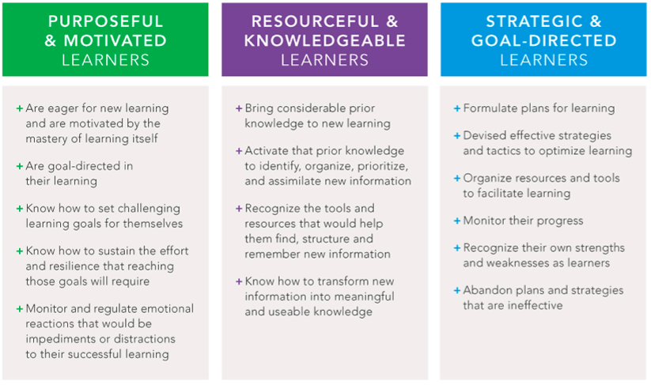
Expert Learners Are…

Slide 13

Expert Learners and Growth Mindset
Expert Learners they know that learning is continuous, that there is no arrival point at which one is finally “expert” and no longer needs to practice.
http://www.mindsetworks.com/

Slide 14
Learner Variability
First we need to incorporate what learning and education science have revealed about the nature of learning into a newly conceived and designed education system.
Two key concepts emerge:
Learner variability is systematic and to a
large degree predictable
Learner capacities are context-dependent
  (David Rose, et.al., UDL: Theory to Practice 2014)

Slide 15



Designing for Learner Variability

Slide 16
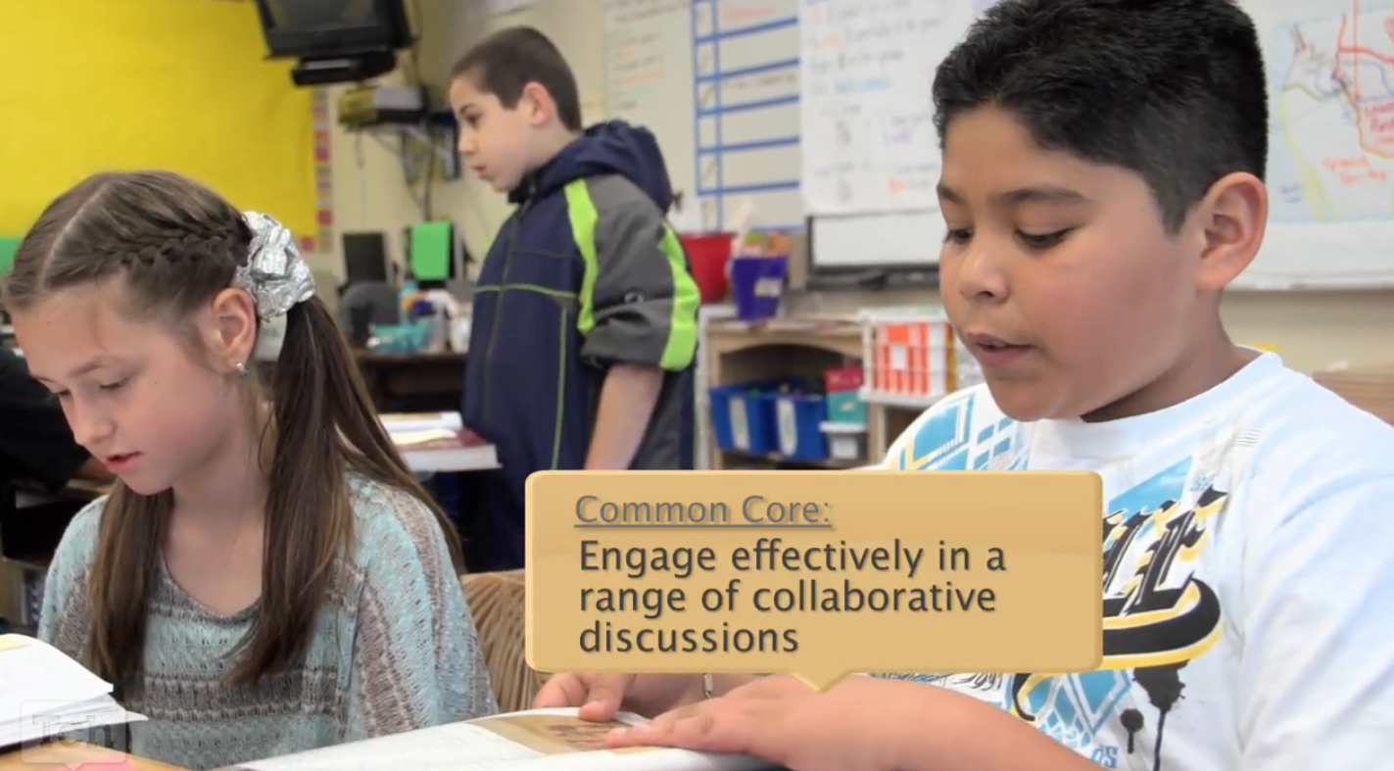

Lesson Analysis
https://www.teachingchannel.org/videos/analyzing-text-brainstorming

Slide 17

What is Universal Design?
Ramps
Curb Cuts
Electric Doors
Captions on Television
Easy Grip Tools…

Slide 18
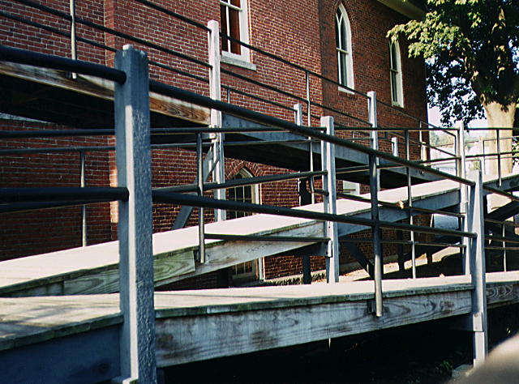
What is Universal Design?
Drawbacks of Retrofitting:
Each retrofit solves only one local
problem
Retrofitting can be costly
Many retrofits are UGLY!

Slide 19


What is the link between architecture and curriculum?
  “Consider the needs of the broadest possible range of users from the beginning.” -- Architect, Ron Mace

Slide 20
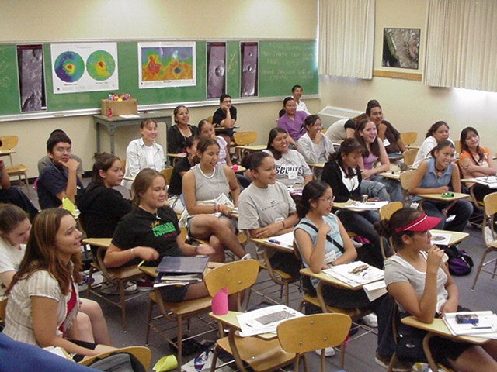
What is Universal Design for Learning?
Is our learning environment welcoming?
UDL is the proactive design of curriculum and instruction to ensure they are educationally accessible regardless of learning style, physical or sensory abilities.
Just as physical barriers exist in our physical environment, curricular barriers exist in our instructional environment.

Slide 21
What is Universal Design for Learning?
UDL provides a blueprint for creating instructional goals, assessments, methods, materials that work for everyone--not a single, one-size-fits-all solution but rather flexible approaches that can be customized and adjusted for individual needs.

Slide 22
What is Universal Design for Learning?
One size does not fit all – but alternatives for everyone.
Not added on later – but designed from the beginning.
Not access for some – but access for everyone.
Diversity is the norm.
Technology is flexible and accessible.
First focus on the curriculum – goals, assessment, methods, and materials; then on individual students.

Slide 23
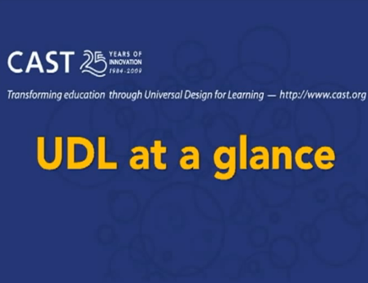
What is Universal Design for Learning?
http://www.cast.org/library/video/udl_intro/index.html

Slide 24
How is UDL Defined?
The term UDL means a scientifically valid framework for guiding educational practice that:
Provides flexibility in the ways students are engaged (engagement), information is presented (recognition), and in the ways students respond or demonstrate knowledge and skills (action and expression), and...

Slide 25
How is UDL Defined?
The term UDL means a scientifically valid framework for guiding educational practice that:
…reduces barriers in instruction, provides appropriate accommodations, supports, and challenges, and maintains high achievement expectations for all students, including students with disabilities and students who are English Language Learners.
(Higher Education Opportunity Act of 2008)

Slide 26
Is UDL Only for Students with Disabilities?
UDL is a framework to support the variability of learners that exist in all classrooms.
This includes gifted students, disengaged students, students with disabilities, students who are English learners, and even the mythical average student.

Slide 27
A Resurgence in UDL Practices?
Integrated into the California ELA Frameworks
Maryland becomes the first state to approve education legislation directly addressing UDL
The principles of UDL are one of the guiding principles for CCSS Consortiums

Slide 28
Integration of Cognition and Emotion
They (the UDL guidelines) explicitly call for the integration of emotion and cognition. We know that students continuously appraise their environment as good for them or bad for them—beneficial or threatening.
- Universal Design for Leaning: Theory and Practice, 2014

Slide 29

What are the internal and external barriers that keep our students, and ourselves, from striving towards our goals?
What could happen if we never gave up on ourselves and others? And our students never gave up on themselves?

Slide 30

“Curriculum” Defined
A Copernican Shift
Goals
Assessment
Methods
Materials

Slide 31
Goals
Separate the means from the ends;
Consider all three learning networks;
Challenge all learners;
Actively involve learners

Slide 32
Standard/Goal Analysis
Tell and write time.
CCSS.Math.Content.1.MD.B.3:
Tell and write time in hours and half-hours using analog and digital clocks.
Goal:
Students will express time in hours and half-hours using analog and digital clocks.

Slide 33
Watch Your Verbs!
Apply Demonstrate Identify Order
Assess Describe Interpret Predict
Classify Diagram Label Reproduce
Compose Distinguish Locate Solve
Construct Estimate Measure State
Define Evaluate Name Translate

Slide 34
Assessment
Are ongoing and focused
on learner progress
Measure both product
and process
Are flexible, not fixed
Are construct relevant*
Actively inform and
involve learners
Formative
Summative
* The information or skill an assessment or assessment item claims to be measuring.

Slide 35
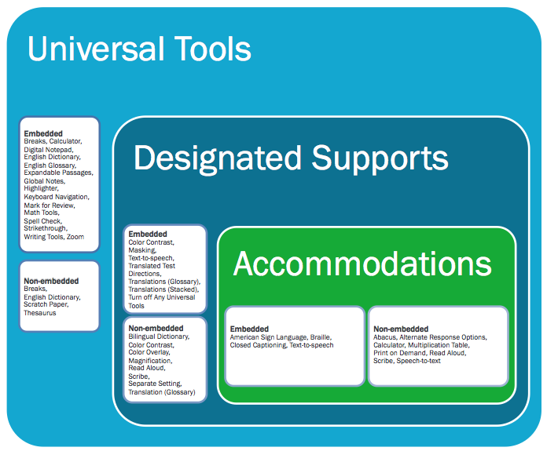
SBAC Usability, Accessibility, and Accommodations Guidelines
http://www.smarterbalanced.org/parents-students/support-for-under-represented-students/

Slide 36
Accessibility Guide for Classroom Activities
The Classroom Activity is designed to be an introduction and not an assessment. All students may be provided instructional supports, scaffolding and/or accommodations used during regular instruction.
http://sbac.portal.airast.org/wp-content/uploads/2014/03/Accessibility-Guide-for-Classroom-Activities-Final.pdf

Slide 37
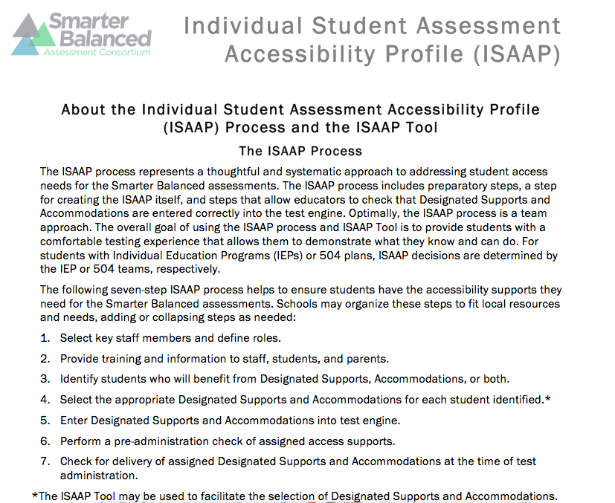
Individual Student Assessment Accessibility Profile (ISAAP)
http://www.smarterbalanced.org/parents-students/support-for-under-represented-students/

Slide 38
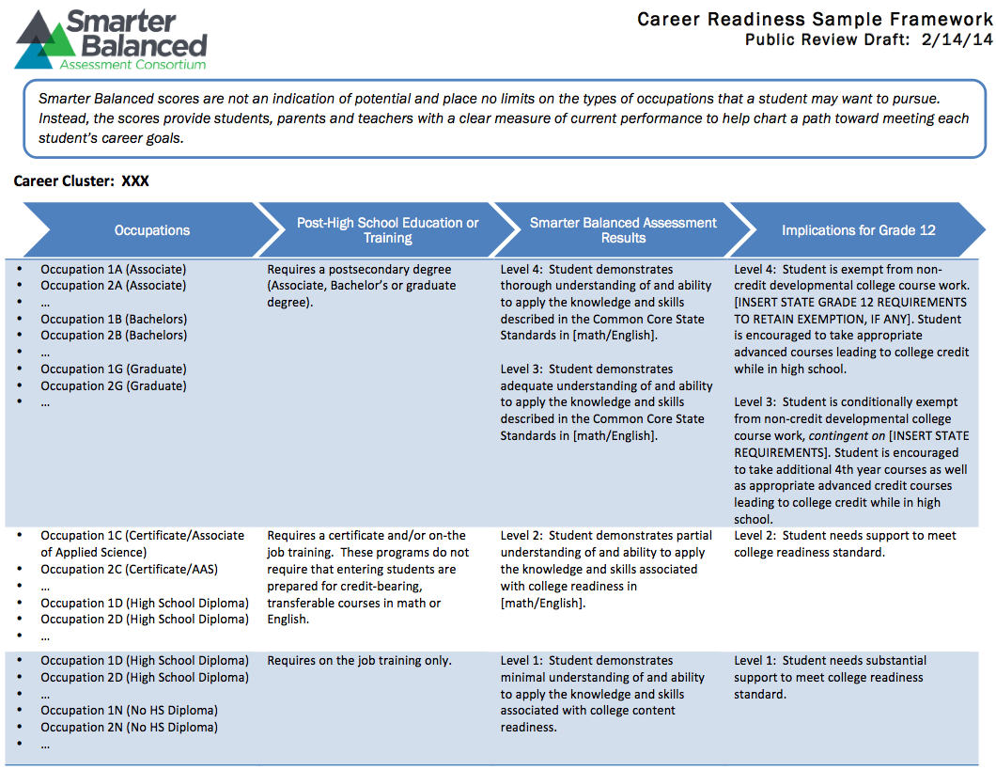
Smarter Balanced Career Readiness
http://www.smarterbalanced.org/wordpress/wp-content/uploads/2014/02/Career-Readiness-Framework-Sample-Layout.docx.pdf

Slide 39


DEPTH OF KNOWLEDGE LEVELS (The Depth of Knowledge is not determined by the verb, but what comes after the verb and the context in which the verb is used, i.e., the depth of thinking required.)
Level 1: Recall and Reproduction Requires recall of information, such as a fact, definition, term, or performance of a simple process or procedure. Answering a level 1 item involves following a simple, well-known procedure or formula. Simple skills and abilities or recall characterize this level.
Level 2: Skills/Concepts Includes the engagement of some mental processing beyond recalling or reproducing a response. Items require students to make some decisions as to how to approach the question or problem. These actions imply more than one mental or cognitive process/step.
Level 3: Strategic Thinking: Requires deep understanding as exhibited through planning, using evidence, and more demanding cognitive reasoning. The cognitive demands at this level are complex and abstract. An assessment item that has more than one possible answer and requires students to justify the response they give would most likely be a Level 3.
Level 4: Extended Thinking Requires high cognitive demand and is very complex. Students are expected to make connections – relate ideas within the content or among content areas – and have to select or devise one approach among many alternatives on how the situation can be solved. Due to the complexity of cognitive demand, this level often requires an extended period of time.
Increased Complexity

Slide 40
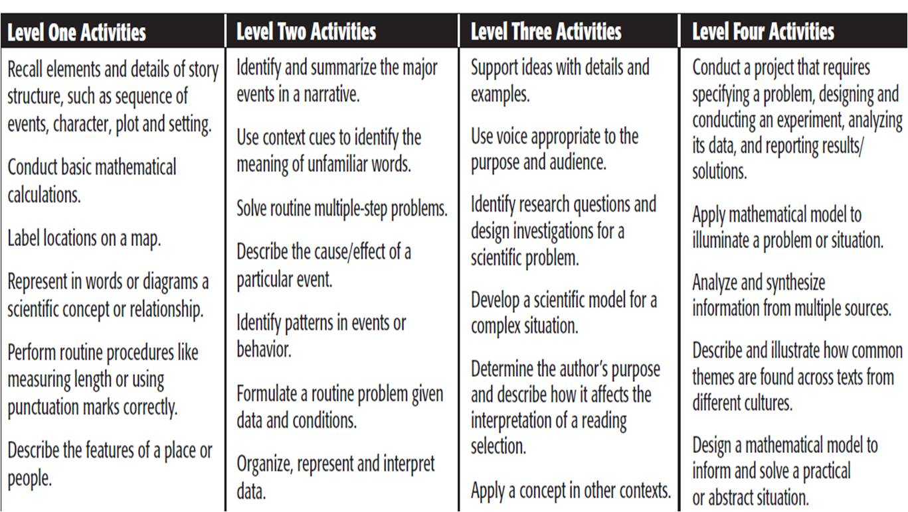
DOK Level Activities
Analyze CCSS, instruction, assessment and goals

Slide 41
Methods
Instructional methods include the decisions, approaches, procedures, and routines that teachers use to accelerate or enhance learning. Because learners vary in the ways they become and stay motivated to learn, comprehend information, and strategically approach tasks, the UDL framework emphasizes the need to employ many kinds of teaching methods. Flexible and varied, these methods are adjusted based on continual monitoring of learner progress.

Slide 42
Methods
To support diverse affective networks:
Offer choices of
content and tools
Offer adjustable levels
of challenge
Offer choices of
rewards
Offer choices of
learning context
To support diverse recognition networks:
Provide multiple
examples
Highlight critical
features
Provide multiple media
and formats
Support background
context
To support diverse strategic networks:
Provide flexible
models of skilled
performance
Provide opportunities
to practice with
supports
Provide ongoing,
relevant feedback
Offer flexible
opportunities for
demonstrating skill

Slide 43
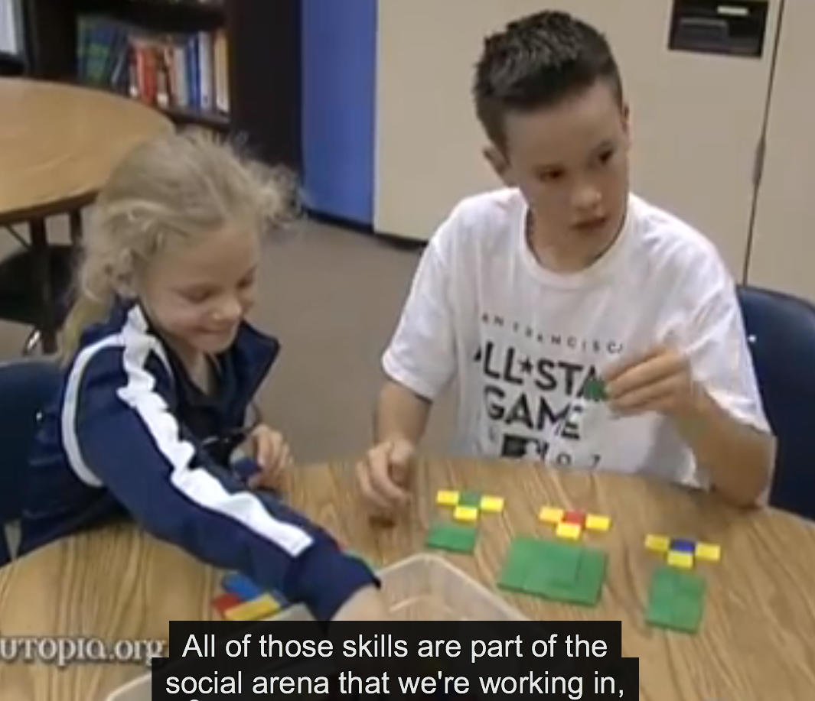
Methods
http://www.edutopia.org/math-social-activity-cooperative-learning-video

Slide 44
Materials
Align to goals
Fixed media of the past, especially print, shaped and even warped our understanding of what it meant to be an effective learner. Essentially, those people who could function well in a print-based environment were favored; we even called them "book smart." Those for whom print presented difficulties-individuals with dyslexia, say, or whose first language was not English, or those who were oriented more toward visual or auditory media-were shut out. Educational materials limited the goals of learning through contingencies and assumptions.

Slide 45
Materials
Engage learners in becoming proactive
Just as educators now have many more options in the post-print age, so do learners. The days of knowledge being dispensed through one of two gatekeepers-the teacher or the textbook-are long gone.

Slide 46
UDL Foundations:
Brain-based Learning Networks
Brain-based research indicates three distinct yet inter related learning networks (Rose, Meyer, Hitchcock, 2005):
  Affective Learning Network (why)
    How motivation & participation impacts learning
  Recognition Learning Network (what)
    How we make sense of presented information
  Strategic Learning Network (how)
    How we demonstrate our learning or mastery

Slide 47
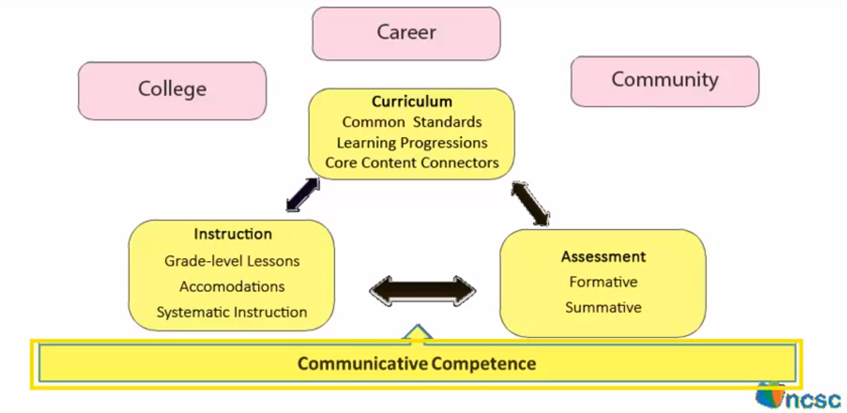
Communicative Competence

Slide 48
Communicative Competence
http://www.montgomeryschoolsmd.org/departments/hiat/udl/examples/examp016.shtm
Communication/Instructional Loop
Communicative Intent
+
Mode of Communication
+
Listener Comprehension
=
Communicative Competence which promotes CCSS-aligned instruction at the student’s functioning level and the development of appropriate goals.
(…and repeat)

Slide 50

Multiple Means of Engagement

Slide 51

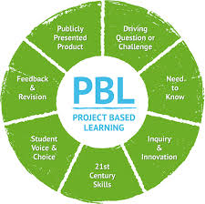
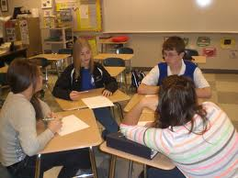
Multiple Means of Engagement

Slide 52
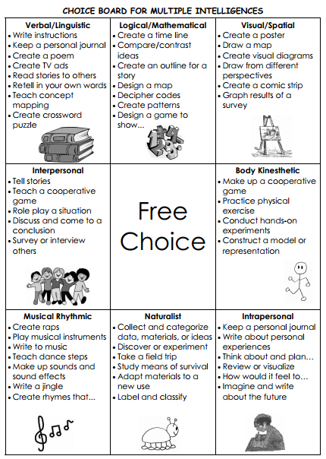
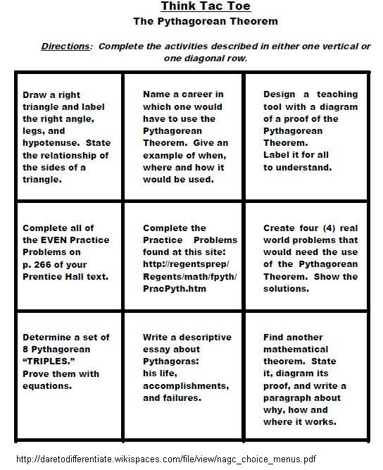
Multiple Means of Engagement

Slide 53
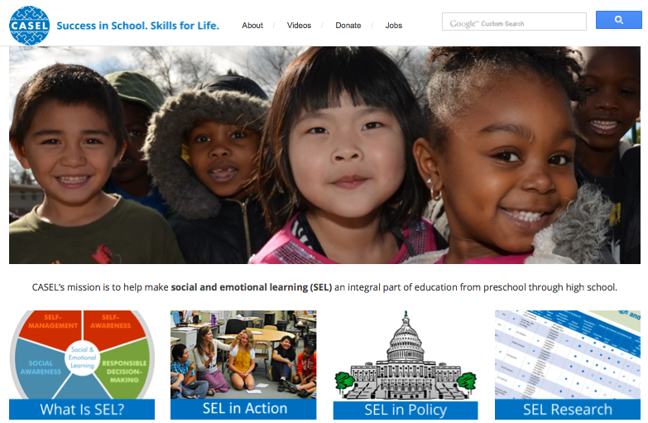
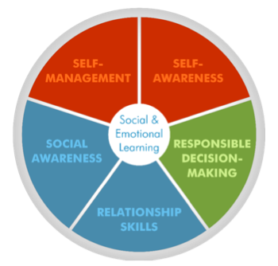
Multiple Means of Engagement
Social/Emotional Learning
www.casel.org

Slide 54
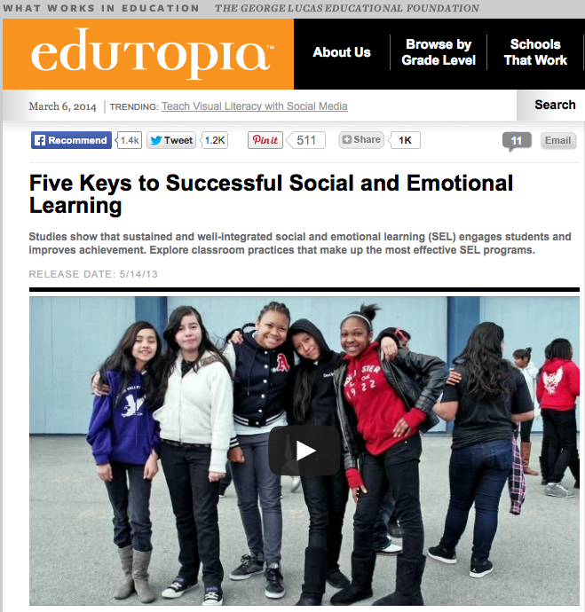
Multiple Means of Engagement
Social/Emotional Learning
http://www.edutopia.org/keys-social-emotional-learning-video

Slide 55

Multiple Means of Engagement
Perseverence
MP1: Make sense of problems and persevere
https://www.teachingchannel.org/videos/math-practice-standard-perseverance

Slide 56

Multiple Means of Engagement
Making Mistakes/Failure
But what if I fail?
You will.
The answer to the what if question is, you will.
A better question might be, "after I fail, what then?”
Well, if you've chosen well, after you fail you will be one step closer to succeeding, you will be wiser and stronger and you almost certainly will be more respected by all of those that are afraid to try.
Seth Godin Linchpin: Are You Dispensible?
Blog: http://sethgodin.typepad.com

Slide 57

Multiple Means of Engagement
Making Mistakes/Failure
https://www.teachingchannel.org/videos/class-warm-up-routine

Slide 58

Multiple Means of Engagement
Grit
Grit on TED
Grit on NPR
Lessons in Grit
Does Teaching Kids to Get Gritty…
http://www.ted.com/talks/angela_lee_duckworth_the_key_to_success_grit

Slide 59


Multiple Means of Engagement
Growth Mindset
http://www.youtube.com/watch?v=pN34FNbOKXc

Slide 60
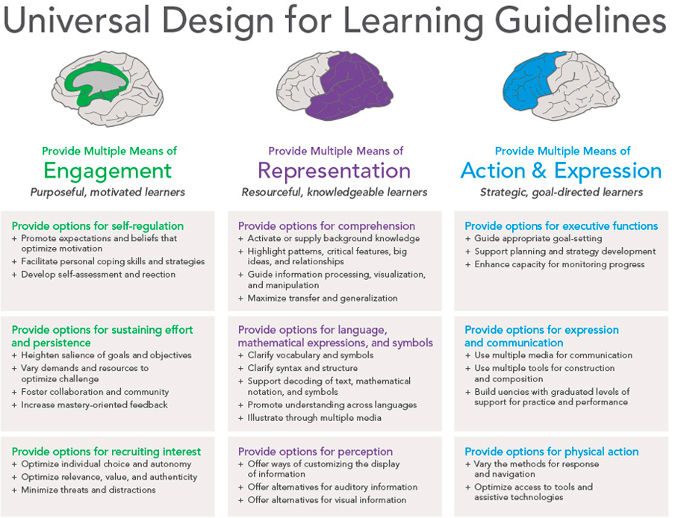
Notes:
The updated UDL Guidelines. The Engagement Principle is moved to a more prominent position noting its importance for student access to curriculum and instruction.

Slide 61
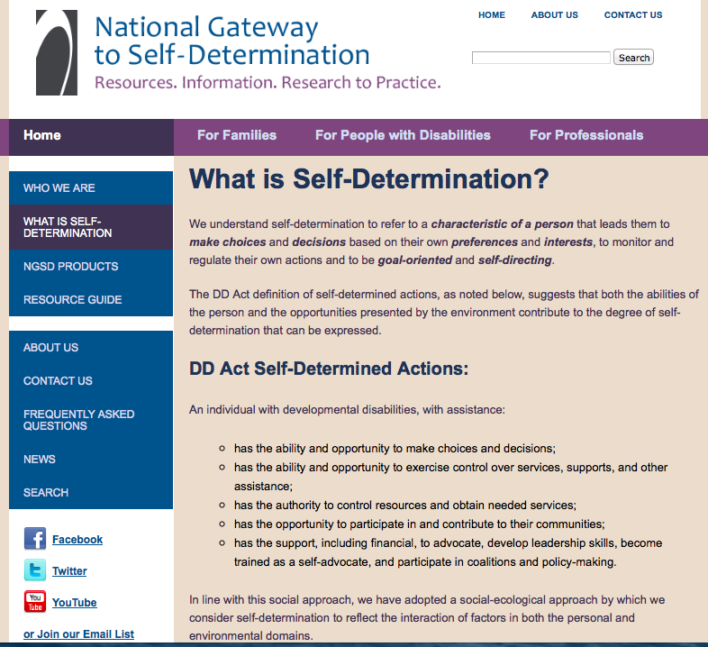
Multiple Means of Engagement
Self-Determination
…a characteristic of a person that leads them to make choices and decisions based on their own preferences and interests, to monitor and regulate their own actions and to be goal-oriented and self-directing.
http://www.ngsd.org/everyone/what-self-determination

Slide 62

Multiple Means of Engagement
Self-Determination
Choice-Making
Decision-Making
Problem-Solving
Goal-Setting
Self-Management/
Self-Evaluation
Self-Awareness

Slide 63
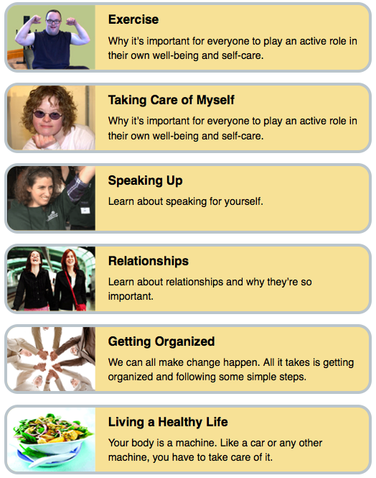
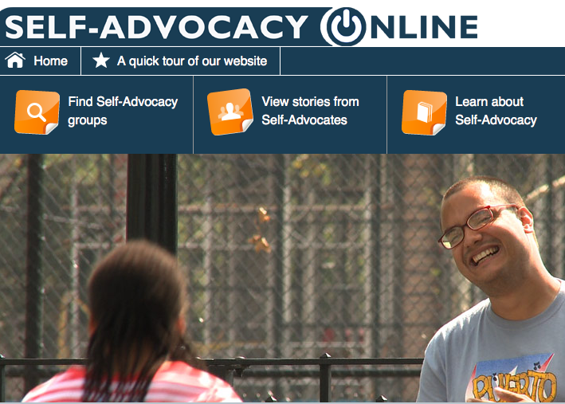
Multiple Means of Engagement
Self-Advocacy
http://www.selfadvocacyonline.org/learning/

Slide 64
Notes:
The updated UDL Guidelines

Slide 65

Multiple Means of Engagement
Observe and Refine a Classroom Lesson
Along with your Awesome/Terrific partner, review your assigned checkpoints within the guideline to which you have been assigned. Observe the following lesson noting UDL curriculum (goals, assessment, methods, and materials) being used as well as noting your suggestions for improved student access.
https://www.teachingchannel.org/videos/passion-for-math

Slide 66

Multiple Means of Representation
Worksheets

Slide 67

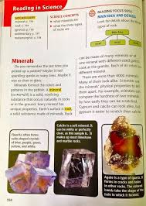
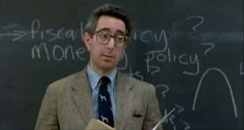
Multiple Means of Representation
Traditional Teacher Textbook

Slide 68
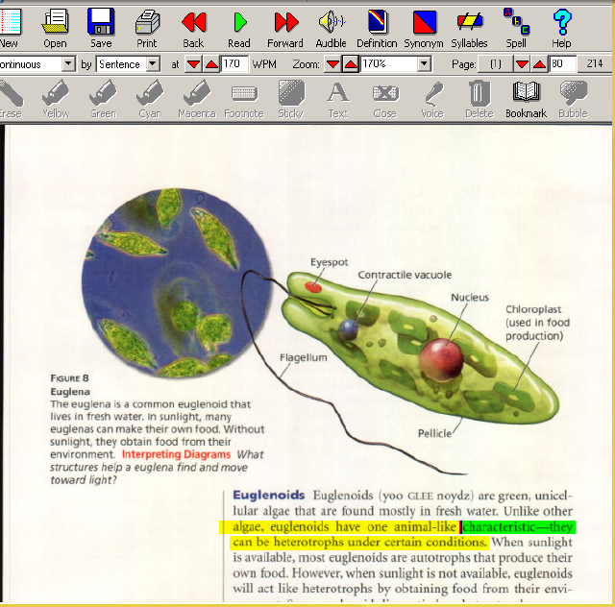
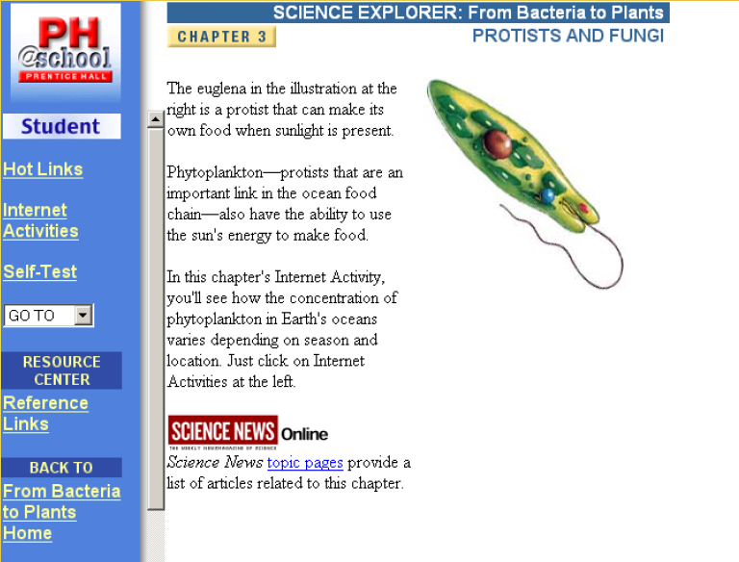
Multiple Means of Representation
Technology
Text-to-speech
Textbook Publisher’s Interactive Website

Slide 69

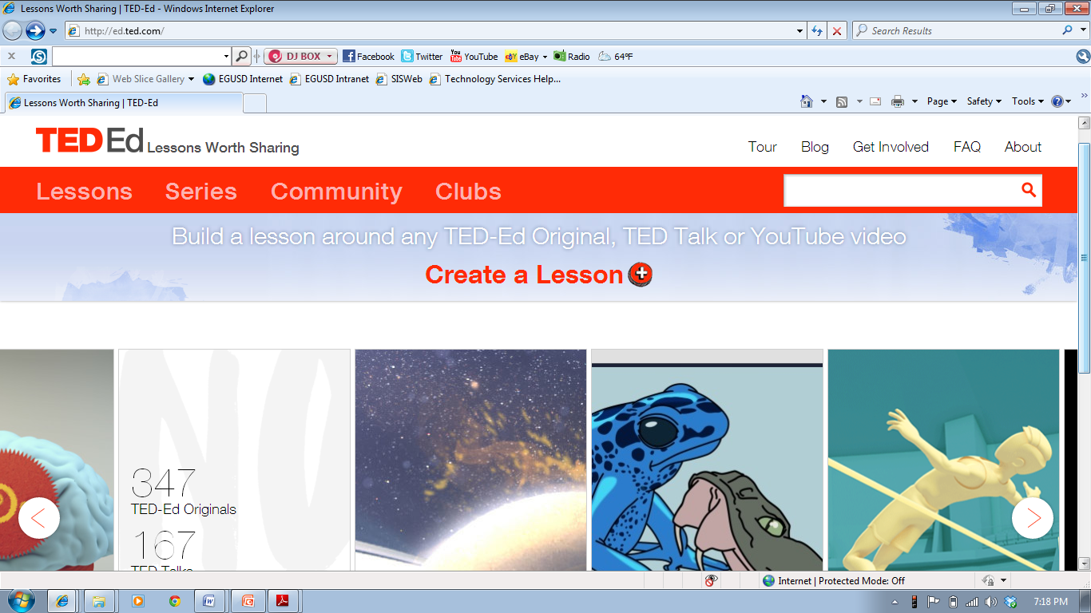
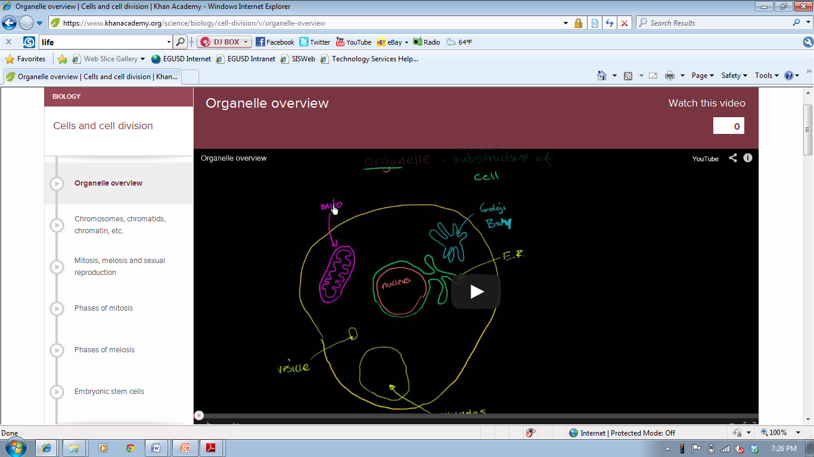
Multiple Means of Representation
Technology
TED-ED—Lessons Worth Sharing
347 TED-Ed Originals
167 TED Talks
59,371 Flipped Lessons

Slide 70
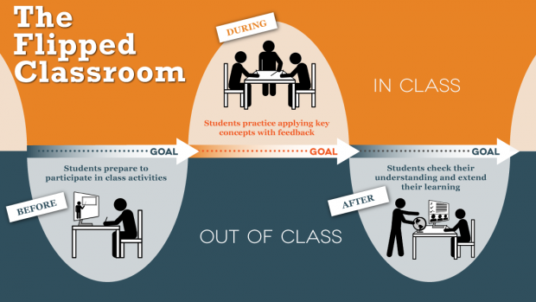
Multiple Means of Representation
Technology

Slide 71
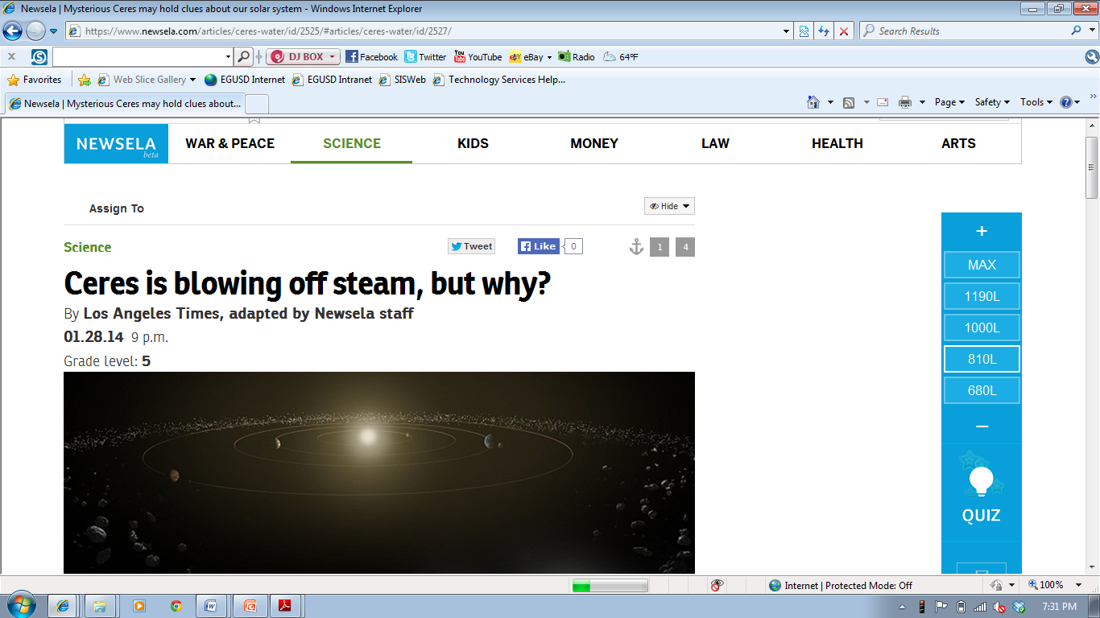
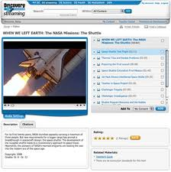
Multiple Means of Representation
Technology
Newsela:
Online source for expository text in multiple lexile levels
Online Education Video Streaming Services

Slide 72

Multiple Means of Representation
Observe and Refine a Classroom Lesson
Along with your Awesome/Terrific partner, review your assigned checkpoints within the guideline to which you have been assigned. Observe the following lesson noting UDL curriculum (goals, assessment, methods, and materials) being used as well as noting your suggestions for improved student access.

Slide 73

Multiple Means of Action and Expression

Slide 74
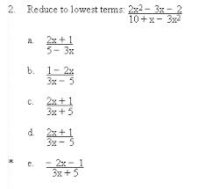
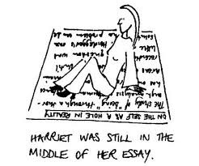


Multiple Means of Action and Expression

Slide 75
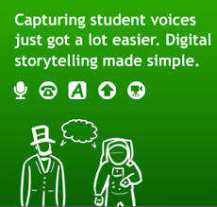
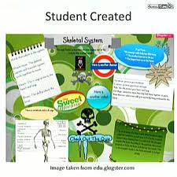
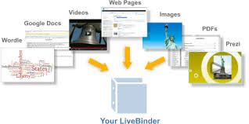


Multiple Means of Action and Expression
Voice Thread
Glogster
LiveBinder
Portfolio

Slide 76
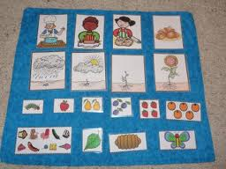
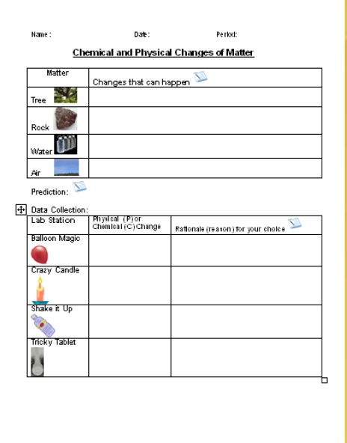

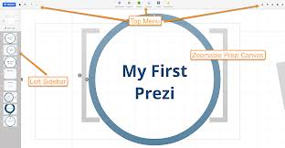
Multiple Means of Action and Expression
Pocket Chart
Popplet App
Graphic Organizer/Chart
Powerpoint/Prezi

Slide 77
Multiple Means of Action and Expression
Executive Functions
Executive function is a set of mental processes that helps connect past experience with present action. People use it to perform activities such as planning, organizing, strategizing, paying attention to and remembering details, and managing time and space. (NCLD)
http://www.ncld.org/types-learning-disabilities/executive-function-disorders/what-is-executive-function

Slide 78
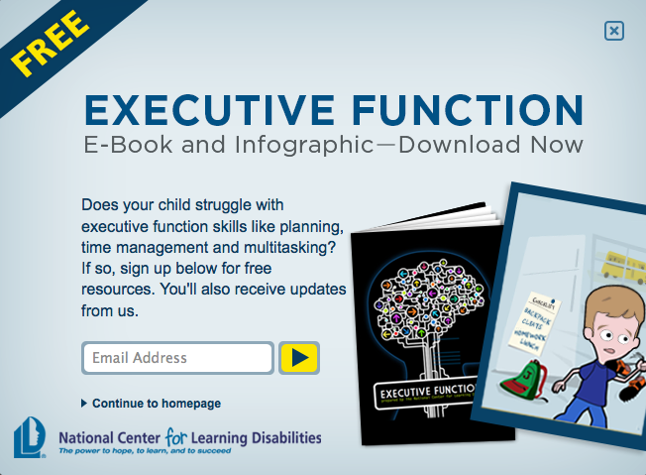
Multiple Means of Action and Expression
Executive Functions

Slide 79

Multiple Means of Action and Expression
Executive Functions
Planning
Organization
Time Management
Working Memory
Metacognition
Response Inhibition
Emotional Control
Sustained Attention
Task Initiation
Flexibility
Goal Directed Persistence

Slide 80
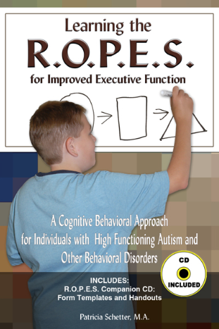
Multiple Means of Action and Expression
Executive Functions
Recall
Organization and Planning
Prioritizing and Goal Setting
Evaluation and
Critical Thinking Skills
Self Management

Slide 81
Multiple Means of Action and Expression
Executive Functions
General Strategies
Take step-by-step approaches to work; rely on visual
organizational aids.
Use tools like time organizers, computers or watches with
alarms.
Prepare visual schedules and review them several times a
day.
Ask for written directions with oral instructions whenever
possible.
Plan and structure transition times and shifts in activities.

Slide 82
Multiple Means of Action and Expression
Executive Functions
Managing Time
Create checklists and “to do” lists, estimating how long tasks will take.
Break long assignments into chunks and assign time frames for completing each chunk.
Use visual calendars at to keep track of long term assignments, due dates, chores and activities.
Be sure to write the due date on top of each assignment.

Slide 83
Multiple Means of Action and Expression
Executive Functions
Managing Space and Materials
Organize work space.
Minimize clutter.
Consider having separate work areas with complete
sets of supplies for different activities.
Schedule a weekly time to clean and organize the work
space.

Slide 84
Multiple Means of Action and Expression
Executive Functions
Managing Work
Make a checklist for getting through assignments. For
example, a student’s checklist could include such items as:
get out pencil and paper; put name on paper; put due
date on paper; read directions; etc.
Meet with a teacher or supervisor on a regular basis to
review work; troubleshoot problems.

Slide 85
Notes:
Q 1: What is Universal Design for Learning?
Universal Design for Learning (UDL) is a research-based framework for designing curricula—that is, educational goals, methods, materials, and assessments—that enable all individuals to gain knowledge, skills, and enthusiasm for learning. This is accomplished by simultaneously providing rich supports for learning and reducing barriers to the curriculum, while maintaining high achievement standards for all students.
Back to Top
Q 2: How does Universal Design for Learning help teachers in real classrooms?
From pre-kindergarten to graduate school, classrooms usually include learners with diverse abilities and backgrounds, including students with physical, sensory, and learning disabilities, differing cultural and linguistic backgrounds, varied preferences and motivations for learning, students who are unusually gifted, and many others.
Universal Design for Learning supports teachers’ efforts to meet the challenge of diversity by providing flexible instructional materials, techniques, and strategies that help teachers differentiate instruction to meet these varied needs. It does this by providing options for:
Presenting information and content in different ways (the "what" of learning)
Differentiating the ways that students can express what they know (the "how" of learning)
Stimulating interest and motivation for learning (the "why" of learning)
A universally designed curriculum is designed from the outset to meet the needs of the greatest number of users, making costly, time-consuming, and after-the-fact changes to curriculum unnecessary.
Back to Top
Q 3: How does UDL help guarantee students equal opportunities to learn?
Both IDEA and NCLB recognize the right of all learners to a high-quality standards-based education. The laws preclude the development of separate educational agendas for students with disabilities and others with special needs. They also hold teachers, schools, districts, and states responsible for ensuring that these students demonstrate progress according to the same standards.
Neither law adequately addresses the greatest impediment to their implementation: the curriculum itself. In most classrooms, the curriculum is disabled. It is disabled because its main components—the goals, materials, methods, and assessments—are too rigid and inflexible to meet the needs of diverse learners, especially those with disabilities. Most of the present ways to remediate the curriculum’s disabilities—teacher-made workarounds and modifications, alternative placements etc.—are expensive, inefficient, and often ineffective for learning.
By addressing the diversity of learners at the point of curriculum development (rather than as an afterthought or retrofit), Universal Design for Learning is a framework that enables educators to develop curricula that truly "leave no child behind" by maintaining high expectations for all students while effectively meeting diverse learning needs and monitoring student progress.
Back to Top
Q 4: How does UDL address the core principles of No Child Left Behind?
Universal Design for Learning supports:
Greater accountability by guiding the development of assessments that provide accurate, timely, and frequent means to measure progress and inform instruction for all students.
Greater flexibility and choice for teachers, parents, and students by guiding the development of curricula that provide high expectations for every student and meaningful choices to meet and sustain those high expectations.
Greater use of evidence-based practices by guiding the design of high-quality curriculum that include research-based techniques for all students, including those with disabilities.
Back to Top
Q 5: I've seen the term universal design but not Universal Design for Learning. What is the difference?
The term "universal design" refers to the movement in architecture and product development that aims to create places or things that are accessible to as many people as possible, including those with disabilities. Speakerphones, curb cuts, and close-captioned television are all examples of universal designs—innovations that benefit a variety of users, including individuals with disabilities. When applied to education, the term "universal design" generally concerns eliminating physical barriers to educational places or materials—for example, providing accessible textbooks.
Of course, increasing physical access is an essential first step. But it is only the beginning. Genuine learning requires much more than physical access—it requires cognitive (or intellectual) access, too. A student with a learning disability may be able to see text clearly (physical access) but may have difficulty understanding the assignment or purpose for reading, finding main points, organizing notes, and expressing understanding (cognitive access). Conversely, a student with cerebral palsy may fully understand an assignment and have clear ideas for executing it (cognitive access) but be blocked from expressing those ideas by inappropriate tools (physical access).
Universal Design for Learning recommends ways to provide cognitive as well as physical access to the curriculum. Students are provided with scaffolds and supports to deeply understand and engage with standards-based material. They not only have access to content and facts, but they learn to ask questions, find information, and use that information effectively. They learn how to learn.
Back to Top
Q 6: How can technology help teachers individualize teaching materials to make learning engaging and challenging for all students?
Technology tools, if designed according to the Web Accessibility Initiative (WAI) and UDL guidelines, can be created to support the individualization necessary to engage all learners, as illustrated by the following examples.
Pam, a student with learning disabilities for whom English is also a second language, uses CAST's eReader software to help her complete a reading assignment. eReader's spoken voice and synchronized highlighting features help her track words on a page, pace her reading, and associate the way a word looks with the way it sounds. After reading the story several times with the spoken voice option turned on and the highlighting speed set to slow, she turns the read aloud feature off, increases the highlighting speed slightly, and reads the story again. In this manner, she works gradually to increase her reading comprehension and speed.
Seth, a student with low vision whose word comprehension skills are excellent, uses eReader to adjust the font, style, size, and color of digital text, background, and highlighting, to achieve maximum contrast and readability.
Jeremy, a poor speller who does not enjoy writing, uses the auditory feedback offered by Don Johnston's Write:OutLoud software to engage in the task of writing an English composition. As he types his composition and it is displayed on the computer screen, the program reads it aloud by word, sentence, paragraph, or letter-by-letter, helping him to identify sentence construction problems and spelling mistakes. When he misspells a word, it flashes on the screen, indicating his error. Using the program's talking spell checker, he calls up a list of suggested words to replace the misspelled word, and, in the case of homonyms, short definitions to distinguish one word from another. Jeremy selects a word when its pronunciation (or definition) indicates it is the correct word, and completes the composition without spelling errors.
Daniel, whose physical disabilities prevent him from using a mouse or a computer keyboard, uses Ke:nx software with Write:OutLoud to gain single switch access to program controls and an onscreen keyboard. In this way, he too can access the writing supports of the program to help him complete his written work.
Ellen, an eighth-grade student with learning disabilities, finds it challenging to utilize the rich resources of the Internet because there is so much information to look at and so many visual distracters. But finding and organizing information from the Web is getting easier for her since her school installed CAST's eTrekker software on its library computers. She signs on, opens eTrekker, and types in a research question such as What did Harriet Tubman do in the Civil War as a nurse? eTrekker checks Ellen's spelling and identifies the keywords in her question, such as Harriet Tubman, Civil War, and nurse. Ellen presses the search button and eTrekker lists ten websites that match her search criteria. eTrekker's interface presents a search engine environment free of distracting advertisements and extraneous information. Ellen selects a few sites to visit, goes to those sites, and, using the reading supports of eReader, which she has also opened on her computer, selects the read feature to have information read aloud to her. eTrekker keeps her research question and keywords on the screen, helping her to maintain focus on the nursing aspect of Tubman's life, rather than her role in the Underground Railroad. Ellen highlights and pastes information into the onscreen notepad and generates some of her own notes on the topic. When she finishes her Internet search, eTrekker stores her research question and keywords, the websites she has visited, and her notes so that she can easily retrieve them.
Back to Top
Q 7: How can the Internet and multimedia be used to individualize learning for students with varied backgrounds, learning styles, abilities and disabilities?
The flexibility of digital media and the varied resources available on the World Wide Web provide great opportunity for individualization. However, care must be taken to structure any learning experience so that the focus remains on the particular goal at hand. This requires preparation and careful consideration of each learner's needs and skills.
Example: A seventh-grade science class, with the help of their teacher, uses Engaging Minds' Inspiration software, a concept mapping program, to create a ‘launch pad' of selected web sites to use when researching the topic of whales. Inspiration enables this diverse group of seventh-grade students, with varied abilities and preferences, to work together to fulfill the goal of the assignment: to find out the best place in the world to film whales for an upcoming movie, and how much such a project might cost. One student, a reluctant reader who does poorly in print-based assignments, excels when it comes to interpreting the data presented in maps and graphs depicting whale migratory patterns. Another student's math skills come to the fore as she analyzes how much it will cost to get a crew to the Gulf of Maine to film humpback whales in action. As the students gather their data, they weave their separate findings into a cohesive whole using Inspiration. When their research is complete, another student uses his visual talents to present the group's findings in a dazzling PowerPoint presentation.

Slide 86
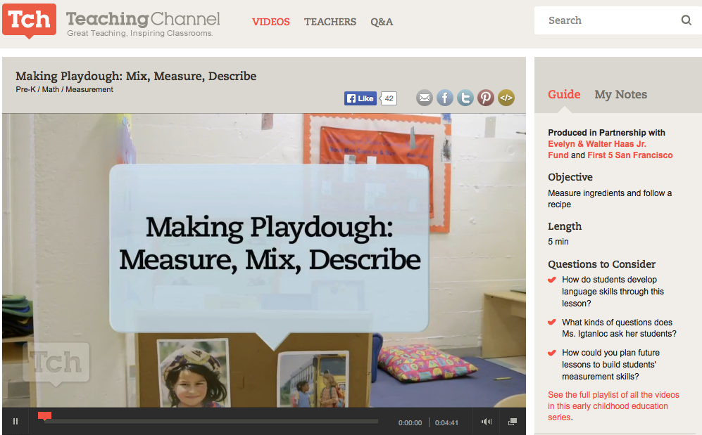
Multiple Means of Action and Expression
Observe and Refine a Classroom Lesson
Along with your Awesome/Terrific partner, review your assigned checkpoints within the guideline to which you have been assigned. Observe the following lesson noting UDL curriculum (goals, assessment, methods, and materials) being used as well as noting your suggestions for improved student access.

Slide 87

Multiple Means of Engagement, Representation, and Action/Expression
Udio: The Universal Literacy Network
Udio is a networked reading environment that displays engaging Web content in a supported, personalized, and pedagogically rich format.
www.cast.org
National Center on the Use of Emerging Technologies to Improve Literacy Achievement for Students with Disabilities in Middle School

Slide 88

Multiple Means of Engagement, Representation, and Action/Expression

Slide 89
Lesson Analysis
https://www.teachingchannel.org/videos/analyzing-text-brainstorming

Slide 90
Four Big Take-Away Ideas
Plan ahead for learner variability
Instruction can and should be flexible and
accessible (when planned)
Multiple representations, output and expression,
and means of engagement will benefit all learners
UDL is the instructional ‘HOW’ for the ‘WHAT’ of
CCSS.

Slide 91

What is one question you might ask the IEP Team at the end of the meeting to determine if the IEP is reasonably calculated?
Why is this question important?

Slide 92

Career Technical Education
Employability Skills Framework
Individuals require many skills to be college, career, and community ready, including academic knowledge, technical expertise, and a set of general cross-cutting abilities termed employability skills.
http://cte.ed.gov/employabilityskills/index.php/framework/index

Slide 93
What Do We Know About
Special Education?
It is both reliant upon and symptomatic of general education
It is a set of supports and services, not a location or a state of treading water
Students with disabilities are general education students first and should be treated as such both instructionally and fiscally
It is intended to accommodate for or address a disability that affects learning, not make up for poor instruction

Slide 94
Preparing Students for a
21st Century Economy
The Connection Economy where businesses and people survive and thrive by connecting with other people. To do this well, we have to constantly seek to do work that adds true value and impacts real people. This is a completely different approach than the mass-market, take a number method engrained from the industrial revolution.
Seth Godin, The Icarus Deception
Blog: http://sethgodin.typepad.com

Slide 95
College and Career Readiness
As students advance through the grades and master the standards…they are able to exhibit with increasing fullness and regularity these capacities of the literate individual.

Slide 96
College and Career Ready
ELA Common Core State Standards
Demonstrate Independence
Build Strong Content Knowledge
Respond to the Varying Demands of Audience,
Task, Purpose and Discipline
Comprehend as well as Critique
Value Evidence
Use Technology and Digital Media Strategically
and Capably
Come to Understand Other Perspectives and
Cultures

Slide 97

Together these standards prepare students for the literacy demands of the 21st Century
College and Career Readiness Anchor Standards
Appendices
A, B, C
Appendices
A, B, C
Reading
K-5
Writing
6-12
Speaking & Listening
Reading for Literacy
in History /Social Studies and Science & Technical Subjects
Writing for Literacy
in History /Social Studies and Science & Technical Subjects
Language

Slide 98
College and Career Ready
8 Mathematical Practices
Make Sense of Problems and Persevere in Solving Them
Reason Abstractly and Quantitatively
Construct Viable Arguments and Critique the Reasoning
of Others
Model with Mathematics
Use Appropriate Tools Strategically
Attend to Precision
Look For and Make Use of Structure
Look For and Express Regularity in Repeated Reasoning

Slide 99


Slide 100
College and Career Ready
National Center and State Collaborative
Communicative Competence
Fluency
Age-Appropriate Social Skills
Independence and Self-Advocacy
Accessing Resources

Slide 101
College and Career Ready
National Center and State Collaborative
Other Factors Not Assessed
Self-Determination
Student Involvement in the IEP
Planning Process
Community-based Vocational Training
and Paid Employment While in School
Community-based Instruction

Slide 102
College and Career Ready
National Center and State Collaborative
Other Factors Not Assessed (cont.)
Inclusion
Working Collaboratively with Peers
Student Knows Own Support Needs
and How to Access
Interagency Transition Collaboration
IEP/ITP Team Creating Ongoing
Support and Links

Slide 103
Organization of CCSS
Numbering of standards is consistent (e.g., writing standard 1 deals with opinion/argument from K-12).
They progressively increase in level of sophistication.
Standards are “divided” K-5/6-12 grade spans where one might see some shifts in language used, although the intent of the standard remains (e.g., “opinion” is used K-5 and then shifts to “argument” 6-12).
Notes:
103

Slide 104
Application to Students with Disabilities
Promoting a culture of high expectations for all students is a fundamental goal of the Common Core State Standards. In order to participate with success in the general curriculum, students with disabilities, as appropriate, may be provided additional supports and services, such as:
• Instructional supports for learning― based on the principles of Universal Design for Learning (UDL) ―which foster student engagement by presenting information in multiple ways and allowing for diverse avenues of action and expression.
• Instructional accommodations (Thompson, Morse, Sharpe & Hall, 2005) ―changes in materials or procedures― which do not change the standards but allow students to learn within the framework of the Common Core.
• Assistive technology devices and services to ensure access to the general education curriculum and the Common Core State Standards.

Slide 105
CCSS RL – Integrated Literacy
Find references to “prompting and support” and “ask and answer questions”
RL.K-12.4: reference to L.K-12.4-6
RL.K-2.5: differentiates between RL and RI
RL.K-5.8: is not applicable
RL.3&4.5: integrates writing and speaking
RL.2.6: integrates speaking
RL.4.7: integrates speaking (oral presentation receptive language)
Note executive functions and ask, “under what conditions will the student demonstrate mastery?
Notes:
Refer to the color coded IEP goal development resource

Slide 106

CCSS RL – Integrated Literacy
CCSS RL.8.6
What is the “essential understanding” contained in this standard?
What are some instructional implications for a student with autism? ID? SLD? ED?
Notes:
Refer to the color coded IEP goal development resource

Slide 107

http://common core.tcoe.org/home

Slide 108

Analysis of the CCSS
CCSS RL.6.7
How many tasks can this standard be broken into?
Is this a receptive or expressive skill?
What are the language-based literacy expectations
contained in this standard?
What cognitive skills are necessary to master this
standard?
Notes:
Refer to the color coded IEP goal development resource

Slide 109
CCSS RI – Integrated Literacy
RI.K-12.4: reference to L.K-12.4-6
RI.4-12.7: integrates listening (info. orally presented)
RI.4&5.9: integrates writing and speaking
RI.2-5.10: integrates history/social studies, science and technical texts
Note executive functions and ask, “under what conditions will the student demonstrate mastery?”
Visit newsela.com
Notes:
Refer to the color coded IEP goal development resource

Slide 110
CCSS RF – Integrated Literacy
RF.K.1-3: note emphasis on spoken words/ phonemic awareness
RF.1.2: note the emphasis on spoken words/ phonemic awareness
RF.1-5.3&4: note progression from spoken words/ phonemic awareness to spelling/sound relationships to decoding/reading
Consider language-based disabilities (auditory processing) when addressing phonemic awareness
Notes:
Refer to the color coded IEP goal development resource

Slide 111
CCSS W – Integrated Literacy
Find references to “guidance and support”
W.K-12.1-3: lists types of writing as 1.opinion/argument; 2.informative/explanatory; 3.narrative
W.6-12.1: “opinion” pieces change to “argument”
W.2-12.4: references “Grade-specific expectations for writing types are defined in writing standards 1-3”
W.3-12.5: references “Editing for conventions should demonstrate command of L standards 1-3”
Reading expectations are included: W.3-12.8 and W.4-12.9
Executive functions are numerous and critical
Notes:
Refer to the color coded IEP goal development resource

Slide 112
CCSS SL – Integrated Literacy
Reading expectations are included: SL.3-12.1
Writing (fine motor) expectations are included: SL.K-5.5
Language expectations are included: SL.1-12.6
Consider language-based disabilities (auditory processing) when addressing oral, i.e., expressive/receptive language
Executive functions are numerous and critical
Notes:
Refer to the color coded IEP goal development resource

Slide 113

CCSS SL – Integrated Literacy
CCSS SL.8.3
What is the “essential understanding” contained in this standard?
What are some instructional implications for a student with autism? ID? SLD? ED?
Notes:
Refer to the color coded IEP goal development resource

Slide 114
CCSS L – Integrated Literacy
Reading AND speaking expectations are included: L.K-12.1
Writing/spelling expectations are included: L.K-12.2
Reading, writing, AND speaking and listening expectations are included: L.2-12.3 and L.9-12.6
Reading and speaking and listening expectations are included: L.K-3.6
Executive functions are numerous and critical
Notes:
Refer to the color coded IEP goal development resource

Slide 115

Analysis of the CCSS
CCSS L.3-5.3
What is the essential understanding(s) of the three
standards above?
What are the integrated literacy expectations?
How are these standards preparing students for
college and career readiness?
Notes:
Refer to the color coded IEP goal development resource

Slide 116
IEP Development
Present Levels of Academic
Achievement and Functional
Performance (PLAAFP)
Special Factors
Goals

Slide 117


Slide 118


PLAAFP
Student Strengths,
Interests, and Preferences
Capitalization Learning
Compensation Learning
NCLD Interview with Gavin Newsom
Notes:
In many cases, the PLAAFP section titled, “Student Strengths, Interests, and Preferences” is paid little attention. It is important to focus on this area as student strengths, interests, and preferences can be used to leverage areas of weakness AND is related to the Engagement Principle of UDL.
Malcolm Gladwell, in “David and Goliath” notes in a chapter on Dyslexia notes examples of very successful individuals who have compensated for their disability and because of this, they have benefitted from a high standard of living. Capitalization Learning is practicing what we are good at, which is typical human behavior. Compensation Learning is cultivating skills that allow for a “work around” to “compensate” for the disability. Gov. Gavin Newsom is an example of a successful individual who has compensated.

Slide 119



Positive Psychology and Happiness
Shawn Achor:
Before Happiness
http://www.ted.com/talks/shawn_achor_the_happy_secret_to_better_work
Shawn Achor:
The Happiness
Advantage
http://goodthinkinc.com/
Notes:
Why you should listen
Shawn Achor is the winner of over a dozen distinguished teaching awards at Harvard University, where he delivered lectures on positive psychology in the most popular class at Harvard.
He is the CEO of Good Think Inc., a Cambridge-based consulting firm which researches positive outliers -- people who are well above average -- to understand where human potential, success and happiness intersect. Based on his research and 12 years of experience at Harvard, he clearly and humorously describes to organizations how to increase happiness and meaning, raise success rates and profitability, and create positive transformations that ripple into more successful cultures. He is also the author of The Happiness Advantage.

Slide 120

PLAAFP
Parent Concerns
W.Y.L.
Notes:
Watch Your Language. Speak in terms parent understands without being condescending. Refrain from using jargon and acronyms.

Slide 121

PLAAFP
Parent Concerns

Slide 122
PLAAFP
Description
The PLAAFP is a brief, detailed description of a student’s achievement and performance at the time the IEP is written and includes all areas affected by the disability.

Slide 123
PLAAFP
Pre-academic/Academic/Functional Skills
Communication
Gross/Fine Motor Development
Social/Emotional/Behavioral Development
Vocational
Adaptive/Daily Living Skills

Slide 124
PLAAFP
Anyone who reads the PLAAFP should
have an understanding of a student’s
strengths, areas of need, be able to plan
standards-based instruction, and develop
goals.
Obtained from various assessments and
data, including information provided by
parent and general education teacher.

Slide 125
PLAAFP
Includes a statement on how the student’s
disability affects his or her involvement
and progress in the general education
curriculum.
Establishes the baseline, that will be used
to gauge measurable annual goals/
benchmarks.

Slide 126
PLAAFP
Four Components
Data-based student specific information related to
current academic achievement and functional
performance from a variety of sources: formative
assessment records, curriculum-based assessments,
formal checklists, input from service providers,
observations and anecdotal records, etc.
Strengths of student
Needs resulting from the disability
Effects of the disability on progress and involvement in
the general education curriculum.

Slide 127

PLAAFP
Written Language Example
Current, Relevant, Objective, Measurable, and Understandable

Slide 128
PLAAFP
Written Language Example
Based on a review of curriculum-based assessments, Kevin’s work samples resulting from weekly writing prompts using a scoring rubric, it is noted that student is able to spell grade level words accurately at 80%. Although sentences are in basic subject/verb format, Kevin is able relate meaning to the reader using legible handwriting. Organization and structure of paragraph are a concern and Kevin is able to write a 5 sentence paragraph and 4 supporting sentences in 1 of 5 trials. Kevin’s written language skills impact writing assignments in all subject areas.
Identify all four components of the PLAAFP in the example above.

Slide 129
Special Factors
Assistive Technology: Does the student require assistive technology devices and services or low incidence services, equipment and materials to meet educational goals and objectives? If yes, specify the type of devices, services, equipment, and/or materials needed.
Low Incidence: This applies only to the students with the following eligibility categories: DB, VI, OI, HH, and Deaf. Low incidence equipment is indicated only if it is required to meet specific educational needs. Check yes or no. If yes, specify. Note: Best practice – assistive technology should be addressed in the Supplemental Aids and Services section and/or in a goal.
^{(cont.)}
Notes:
The Individuals with Disabilities Education Act (IDEA) lists five special factors that the IEP team must consider in the development, review, and revision of each child’s IEP. Read IDEA’s exact words.
The discussion below will highlight the importance of these special factors in the education of children with disabilities and the need for individualized consideration of these factors in IEP development and revision. The special factors are:
Behavior
Limited English proficiency
Blindness or visual impairment
Communication needs/Deafness
Assistive technology
IDEA’s Exact Words
IDEA’s regulations for considering these special factors appear at §300.324(a)(2)(i)-(v) and read as follows:
(2) Consideration of special factors. The IEP Team must—
(i) In the case of a child whose behavior impedes the child’s learning or that of others, consider the use of positive behavioral interventions and supports, and other strategies, to address that behavior;
(ii) In the case of a child with limited English proficiency, consider the language needs of the child as those needs relate to the child’s IEP;
(iii) In the case of a child who is blind or visually impaired, provide for instruction in Braille and the use of Braille unless the IEP Team determines, after an evaluation of the child’s reading and writing skills, needs, and appropriate reading and writing media (including an evaluation of the child’s future needs for instruction in Braille or the use of Braille), that instruction in Braille or the use of Braille is not appropriate for the child;
(iv) Consider the communication needs of the child, and in the case of a child who is deaf or hard of hearing, consider the child’s language and communication needs, opportunities for direct communications with peers and professional personnel in the child’s language and communication mode, academic level, and full range of needs, including opportunities for direct instruction in the child’s language and communication mode; and
(v) Consider whether the child needs assistive technology devices and services. [§300.324(a)(2)]
The IEP team must determine if any of these factors are relevant for the child and, if so, address the factor in the child’s IEP.
Special Factor 1: Behavior
When the IEP meeting rolls around to considering the special factors, the team might begin by asking:
Does this child’s behavior interfere with his or her learning or the learning of others?
If the answer is “yes,” then the team must consider the use of positive behavioral interventions and supports, and other strategies, to address that behavior [§300.324(2)(i)]. Members will talk about what the child needs and include this information in the IEP. As indicated in IDEA, this will include consideration of the use of positive behavioral interventions and supports (PBIS) and other strategies to address the child’s behavior.
More about PBIS and IDEA
The behavior challenges that accompany many children to class these days are well known and of great concern to educational stakeholders from the classroom level up to Congress and back down again. Congress addressed how behavior problems can affect a child’s learning, or the learning of others, in the 1997 reauthorization of IDEA. IDEA ’97 also explicitly involved the IEP team in considering whether positive behavior supports or other strategies were necessary when a child’s behavior was interfering with learning—either the child’s own learning, or the learning of others in the class or school. Functional behavioral assessments became an important and required element in determining why a child was behaving in disruptive or challenging ways, and behavior intervention plans detailed how the problem would be addressed.
PBIS plays a role in the broader picture of addressing child behavior. It is intended to be used before problem behaviors become interfering behaviors, is based upon understanding why a child has problem behaviors and what strategies might be helpful, and seeks to stop or reduce the problem behaviors so that punishment is not necessary. Much research has been conducted into its effectiveness.
An excellent resource on this topic is the National Technical Assistance Center on Positive Behavioral Interventions and Supports (PBIS) that the Office of Special Education Programs (OSEP) funds. The Center strongly recommends adopting a schoolwide system of PBIS, which has been found to be more effective than individual responses to disciplinary infractions and child misbehavior.
Here are three especially useful ones on the PBIS Web site.
State contact information
http://www.pbis.org/links/pbis_network/default.aspx
Implementer’s blueprint and self-assessment for schoolwide behavior support
http://www.pbis.org/pbis_resource_detail_page.aspx?Type=3&PBIS_ResourceID=216
FACTS, a two-page interview completed by people (teachers, family, clinicians) who know the child best, and used to either build behavior support plans, or guide more complete functional assessment efforts.
http://www.pbis.org/pbis_resource_detail_page.aspx?Type=4&PBIS_ResourceID=246
Determining What Behavior Supports Are Needed
How does the IEP team determine what behavior supports might be appropriate and effective for a specific child? As pointed out in the IEP Team section on the regular education teacher, IDEA 2004 indicates that one of the roles of the regular education teacher on the team may include determining what behavior supports and other strategies would be appropriate for the child [§300.324(a)(3)]. This includes supplementary aids and services and program modifications and support for school personnel.
Certainly, functional behavioral assessment, or FBA, can also play a critical part in determining what behavior supports a child needs. According to the Center for Effective Practice and Collaboration (2006):
Functional behavioral assessment is generally considered to be a problem-solving process for addressing child problem behavior. It relies on a variety of techniques and strategies to identify the purposes of specific behavior and to help IEP Teams select interventions to directly address the problem behavior.
Within FBA, behavior is seen as serving a purpose, as communication, as performing some function for the child. FBA’s goal is to identify what that purpose, function, or communication is for the child. Understanding why a child misbehaves is crucial to developing appropriate behavior supports.
Thus, for IEP teams considering the special factor of “positive behavioral interventions and supports and other strategies,” the FBA may be a crucial step in determining why the child is behaving in a way that impedes his or her learning or that of others. Fortunately, many resources exist to help IEP teams address behavior issues in IEP development. We’ve already mentioned the OSEP-funded PBIS Center. Have a look at the list below of additional resources that teams may find helpful. It’s brief, yes, but oh, will it lead you to more!
Resources on Behavior, PBIS, FBAs, and BIPs
3-part Series for IEP Teams
Center for Effective Practice and Collaboration
Available at: http://cecp.air.org/fba/default.asp
5-part Suite on Behavior
National Dissemination Center for Children with Disabilities (NICHCY)
http://nichcy.org/schoolage/behavior/
Here are two resources you may find helpful for addressing assessment issues.
Synthesis Brief: English Language Learners with Disabilities speaks to the challenges educators face in assessing children when English is not their native language. The brief also presents research-based recommendations that school districts may find very helpful. Find this publication online at Project Forum: http://www.projectforum.org/docs/ells.pdf
Another publication schools may find helpful comes from the National Center on Educational Outcomes (NCEO). It’s called Standards-based Instructional Strategies for English Language Learners with Disabilities, and is available online at: http://www.cehd.umn.edu/NCEO/Onlinepubs/ELLsDis18/ELLsDisRpt18.pdf
How is “limited English proficiency” defined? | IDEA defines “limited English proficient” at §300.27 as meaning the same thing as the definition given in section 9101(25) of the Elementary and Secondary Education Act (ESEA), which reads:
“(25) LIMITED ENGLISH PROFICIENT.—The term ‘limited English proficient’ when used with respect to an individual, means an individual—
“(A) Who is aged 3 through 21;
“(B) Who is enrolled or preparing to enroll in an elementary school or secondary school;
“(C)(i) who was not born in the United States or whose native language is a language other than English;
“(ii)(I) who is a Native American or Alaska Native, or a native resident of the outlying areas; and
“(II) who comes from an environment where a language other than English has had a significant impact on the individual’s level of English language proficiency; or
“(iii) who is migratory, whose native language is a language other than English, and who comes from an environment where a language other than English is dominant; and
“(D) whose difficulties in speaking, reading, writing, or understanding the English language may be sufficient to deny the individual—
“(i) the ability to meet the State’s proficient level of achievement on State assessments described in section 1111(b)(3);
“(ii) the ability to successfully achieve in classrooms where the language of instruction is English; or
“(iii) the opportunity to participate fully in society.”
Special Factor 3: Blindness and Visual Impairment
The third special factor relates to the needs of children who are blind or visually impaired. For these children, the IEP team must provide for instruction in Braille and the use of Braille—unless the team “determines, after an evaluation of the child’s reading and writing skills, needs, and appropriate reading and writing media (including an evaluation of the child’s future needs for instruction in Braille or the use of Braille), that instruction in Braille or the use of Braille is not appropriate for the child [§300.324(2)(iii)].
Helpful checklist for IEP teams | A helpful checklist is provided as Resource D-5 in Building the Legacy, NICHCY’s training curriculum on IDEA, and can help IEP teams consider this special factor.
Considerations for this special factor | Following the words and logic of IDEA’s requirement, you can see that the IEP team will need to “provide for instruction in Braille and the use of Braille,” unless...
…the team determines that instruction in Braille or the use of Braille is not appropriate for the child. And the team can only determine that…
…after an evaluation of the child’s reading and writing skills, needs, and appropriate reading and writing media.
Such an evaluation also must include an evaluation of the child’s future needs for instruction in Braille or the use of Braille.
The specific focus of this special consideration is on a child’s need for Braille instruction. The IEP team must also consider other appropriate supports and instruction to address a child’s needs related to blindness or visual impairment. Having accessible instructional materials is essential. Some examples include enlarged print materials, audiotaped materials, math manipulatives, or NIMAS-formatted materials.
Obviously, considering this special factor involves doing so with great deliberation and after gathering the necessary data and evaluation information. Blindness and visual impairment can impact almost all areas related to a child’s academic and non-academic participation in school and must be thoroughly understood by a child’s IEP team.
Statistics on Children Who Are Blind or Visually Impaired
Children in U.S. who are legally blind: 55,200 (American Foundation for the Blind, 2006)
Children 6-21 in U.S. served under IDEA’s category “Visual Impairments”: 26,113 (U.S. Department of Education, 2006)
Children in U.S. using Braille as their primary reading medium: 5,500 (American Foundation for the Blind, 2006)
Special Factor 4: Communication Needs, Especially When Child is Deaf or Hard of Hearing
The fourth special factor that the IEP team must consider when developing a child’s IEP is that child’s communication needs. In the case of a child who is deaf or hard of hearing, team members must consider the child’s:
language and communication needs;
opportunities for direct communications with peers and professional personnel in the child’s language and communication mode;
academic level; and
full range of needs, including opportunities for direct instruction in the child’s language and communication mode [§300.324(2)(iv)].
It’s important to note that, regardless of a child’s disability, IEP teams must consider a child’s communication needs. In determining the child’s communication needs, the IEP team might ask:
What communicative demands and opportunities does the child have?
Does the child have the skills and strategies necessary to meet those communicative demands and take advantage of communicative opportunities?
Can the child fulfill his or her need to communicate in different settings?
Does the child communicate appropriately and effectively, and if not, why not? How would the deficit in communication be described?
Considering a Child’s Communication Needs
If the IEP team determines that the child has communication needs, then the team will need to address these in the IEP, including (as appropriate) through the statement of annual goals, provision of special education and related services, supplementary aids and services, which includes assistive technology, or other relevant instruction, services, and supports.
Considering the many elements included in this special factor will no doubt engage the IEP team in substantial discussion. The following may be helpful in framing and/or informing those discussions.
Communication modes | In the definition of “native language” (§300.29), “mode of communication” is described:
(b) For an individual with deafness or blindness, or for an individual with no written language, the mode of communication is that normally used by the individual (such as sign language, Braille, or oral communication). [§300.29(b)]
Some children with disabilities may use one or more of the modes of communication mentioned above. Other children (those with more severe disabilities, such as deaf/blindness, severe cognitive or physical impairments, or more severe forms of autism) may not be able to communicate adequately in any of those ways. Without question, the communication needs of these children must be taken into consideration when developing the IEP.
Understanding how a child does (or does not) communicate is paramount to designing appropriate instruction and services. And while any significant impairment in a child’s ability to understand and use language plays an enormous role in a child’s ability to learn and make progress in the general education curriculum, it does not, in and of itself, mean that a child cannot learn and make progress. Indeed, meeting and supporting a child’s communication needs can be pivotal to the child’s full participation and progress in the general education curriculum and nonacademic activities.
Alternative ways of communicating | What are some of the alternative ways of communicating? Here are some examples of different communication modes, from very basic to highly sophisticated.
Eye gaze/eye pointing
Facial expression/body language/gestures
Head nod yes/no
Vocalizations/word approximations
Object/picture/photo symbols
Communication symbols
Sign language
Facilitated Communication via Assistive Technology
AAC or Aug Comm device
Communication methods in deafness | For children who are deaf or who have a hearing impairment (see statistics further below), there are a variety of different modes for communicating, including:
Auditory/Oral Method
Auditory-Verbal Method
Cued Speech Method
American Sign Language (Bilingual/Bicultural)
Total Communication Method. (U.S. Department of Education, 2005)
The first three of these—auditory/oral, auditory-verbal, and cued speech—all include a spoken language approach to communicating. More about all these approaches is available at:
Alexander Graham Bell Association, http://www.agbell.org
American Society for Deaf Children,
http://www.deafchildren.org/index.php/component/content/?view=featured&Itemid=489
Laurent Clerc National Deaf Education Center, http://www.gallaudet.edu/clerc_center/information_and_resources/info_to_go.html/index.html
National Institute on Deafness and Other Communication Disorders Information Clearinghouse, http://www.nidcd.nih.gov/health/hearing/Pages/Default.aspx
Interpreting services | IEP teams may find it useful to examine the definition of interpreting services to determine how the communication needs of children who are deaf or hearing impaired can be addressed. Interpreting services are listed in IDEA as a “related service” and, when used with respect to children who are deaf or hard of hearing, include:
(i) Oral transliteration services, cued language transliteration services, sign language transliteration and interpreting services, and transcription services, such as communication access real-time translation (CART), C-Print, and TypeWell; and
(ii) Special interpreting services for children who are deaf-blind. [§300.34(c)(4)]
As a related service, then, these interpreting services may be made available to the child, if the IEP team determines that he or she needs the service in order to benefit from special education.
Supplementary aids and services | Supplementary aids and services are also used to support a child with disabilities and must be specified by the IEP team on the child’s IEP if the team determines that the child needs such services. These often are relevant for children who are deaf or who have hearing loss. They are defined as:
…aids, services, and other supports that are provided in regular education classes, other education-related settings, and in extracurricular and nonacademic settings, to enable children with disabilities to be educated with nondisabled children to the maximum extent appropriate in accordance with §§300.114 through 300.116.
The IDEA 2004 has modified this definition from the one used previously—it now includes extracurricular and nonacademic settings within its scope. This addition is in keeping with this special factor’s emphasis upon the child’s opportunities to communicate with peers and professional personnel in his or her language or communication mode. Supplementary aids and services provided in extracurricular and nonacademic settings will now enlarge the range of settings in which the child would have such communication opportunities.
Statistics on Children Who Are Deaf or Hard of Hearing
Children in U.S. born with hearing loss every year: 12,000 (Alexander Graham Bell Association for the Deaf and Hard of Hearing, 2006)
Children under 18 with hearing loss: 17 of every 1,000 (National Institute on Deafness and Other Communication Disorders, 2006)
Children 6-21 in U.S. served under IDEA’s category “Hearing Impairments”: 71,964 (U.S. Department of Education, 2006)
Back to top
Helpful Materials
A helpful checklist is provided as Resource D-6 in Building the Legacy, NICHCY’s training curriculum on IDEA, and can help IEP teams shape their discussion of this special factor and make appropriate determinations for a child who is deaf or hard of hearing.
A rich source of information on communication can also be found in the Communication Fact Sheets for Parents series of the National Technical Assistance Consortium for Children and Young Adults Who Are Deaf-Blind (NTAC), a member of OSEP’s TA&D Network. You’ll find these online at: http://www.nationaldb.org/documents/products/communication-a.pdf
Special Factor 5: Assistive Technology
The fifth and final special factor that the IEP team must consider relates to whether the child needs assistive technology (AT) devices and services.
Helpful checklist for IEP teams | A helpful checklist is provided as Resource D-9 in Building the Legacy, NICHCY’s training curriculum on IDEA, and can help IEP teams consider this special factor.
IDEA 2004’s definitions | The definitions of AT devices and AT services contained in IDEA 2004 read as follows:
§300.5 Assistive technology device.
Assistive technology device means any item, piece of equipment, or product system, whether acquired commercially off the shelf, modified, or customized, that is used to increase, maintain, or improve the functional capabilities of a child with a disability. The term does not include a medical device that is surgically implanted, or the replacement of such device.
___________
§300.6 Assistive technology service.
Assistive technology service means any service that directly assists a child with a disability in the selection, acquisition, or use of an assistive technology device. The term includes—
(a) The evaluation of the needs of a child with a disability, including a functional evaluation of the child in the child’s customary environment;
(b) Purchasing, leasing, or otherwise providing for the acquisition of assistive technology devices by children with disabilities;
(c) Selecting, designing, fitting, customizing, adapting, applying, maintaining, repairing, or replacing assistive technology devices;
(d) Coordinating and using other therapies, interventions, or services with assistive technology devices, such as those associated with existing education and rehabilitation plans and programs;
(e) Training or technical assistance for a child with a disability or, if appropriate, that child’s family; and
(f) Training or technical assistance for professionals (including individuals providing education or rehabilitation services), employers, or other individuals who provide services to, employ, or are otherwise substantially involved in the major life functions of that child.
Considering AT
Assistive technology devices can help many children do certain activities or tasks. Examples of these devices are:
devices that make the words bigger on the computer screen or that “read” the typed words aloud—which can help children who do not see well;
electronic talking boards—which can help students who have trouble speaking; and
computers and special programs for the computer—which can help students with all kinds of disabilities learn more easily.
AT must be considered for all children with disabilities, regardless of disability, and as is true for other special factors, consideration must be individualized. Assistive technology services include evaluating the child to see if he or she could benefit from using an assistive device. These services also include providing the devices and training the child (or family or the professionals who work with the child) to use the device.
For many children, the first line of inquiry is whether the child’s IEP can be implemented satisfactorily in the regular educational environment with the use of supplementary aids and services. Since AT devices or services can be provided as supplementary aids or services, a child’s IEP team may need to consider whether a particular child requires a particular AT device or service, or whether school personnel require aid or support to enable a child with a disability to be educated satisfactorily in the regular education environment. Section 300.320(a)(4) of IDEA requires the IEP team to include a statement of the special education and related services and supplementary aids and services, based on peer-reviewed research to the extent practicable, to be provided to the child, or on behalf of the child. This would include any AT devices and services (determined by the IEP team) that the child needs in order for the child to receive a free appropriate public education (FAPE).
Another topic that an IEP team may need to consider on a case-by-case basis is whether a child with a disability may need to use a school-purchased AT device in settings other than school, such as the child’s home or other parts of the community, in order for the child to receive FAPE.
The ABCs of AT
According to the Family Center on Technology and Disability (FCTD), “Assistive technology is any kind of technology that can be used to enhance the functional independence of a person with a disability” (2006, p. 2). FCTD’s fact sheet called Assistive Technology 101 can help IEP teams learn more about AT and lay the foundation for its discussion. The fact sheet is available online (along with all of FCTD’s fact sheets), at: http://www.fctd.info/resources/index.php
FCTD also offers a fact sheet called Assistive Technology and the IEP that can be helpful to the IEP team when it examines a child’s needs for AT devices and/or services. Find it at:
http://www.fctd.info/resources/AT_IEP.php
State AT Projects
State-level contacts and technical assistance centers exist to support capacity building with respect to AT and keep abreast of this rapidly developing field. The spectrum of available AT devices has grown remarkably just in the time span since this special factor was introduced into the law as part of the 1997 amendments to IDEA. Get in touch with the contacts and centers in your State, which you can identify through these two sources of information:
NICHCY’s State Organizations, under “state agencies” and these headings : “Technology-Related Assistance; Special Format Books for Children and Youth” and “Regional ADA & IT Technical Assistance Center:
Available online at: http://nichcy.org/state-organization-search-by-state
FCTD’s members page, at:
http://www.fctd.info/organizations
A Starter List of Additional Information
Assistive Technology: Strategies, Tools, Accommodations and Resources (ATSTAR)
A series of online teacher training modules with supporting CD-based videos, designed to help teachers learn to use assistive technology in the classroom.
http://www.atstar.org/index.html
National Assistive Technology Technical Assistance Partnership (NATTAP)
Technical assistance to the 56 State and territory AT programs authorized under the Assistive Technology Act of 1998, as amended.
http://www.resnaprojects.org/nattap/
Family Information Guide to Assistive Technology (in English and Spanish)
http://www.fctd.info/resources/fig_summary.php

Slide 130
Special Factors
Blindness or Visual Impairment: Is the student blind or visually impaired? If the student is visually impaired, indicate whether instruction in Braille will be provided, and if not, why? If the student will not be using Braille he/she may use large print text or other modified input.
Deaf or Hard of Hearing: If the student is deaf or hard of hearing, consider the student’s language and communication needs, opportunities for direct communications with peers and professional personnel in the student’s language and communication mode, academic level, and full range of needs including opportunities for direct instruction in the student’s language and communication mode.
^{(cont.)}
Notes:
The Individuals with Disabilities Education Act (IDEA) lists five special factors that the IEP team must consider in the development, review, and revision of each child’s IEP. Read IDEA’s exact words.
The discussion below will highlight the importance of these special factors in the education of children with disabilities and the need for individualized consideration of these factors in IEP development and revision. The special factors are:
Behavior
Limited English proficiency
Blindness or visual impairment
Communication needs/Deafness
Assistive technology
IDEA’s Exact Words
IDEA’s regulations for considering these special factors appear at §300.324(a)(2)(i)-(v) and read as follows:
(2) Consideration of special factors. The IEP Team must—
(i) In the case of a child whose behavior impedes the child’s learning or that of others, consider the use of positive behavioral interventions and supports, and other strategies, to address that behavior;
(ii) In the case of a child with limited English proficiency, consider the language needs of the child as those needs relate to the child’s IEP;
(iii) In the case of a child who is blind or visually impaired, provide for instruction in Braille and the use of Braille unless the IEP Team determines, after an evaluation of the child’s reading and writing skills, needs, and appropriate reading and writing media (including an evaluation of the child’s future needs for instruction in Braille or the use of Braille), that instruction in Braille or the use of Braille is not appropriate for the child;
(iv) Consider the communication needs of the child, and in the case of a child who is deaf or hard of hearing, consider the child’s language and communication needs, opportunities for direct communications with peers and professional personnel in the child’s language and communication mode, academic level, and full range of needs, including opportunities for direct instruction in the child’s language and communication mode; and
(v) Consider whether the child needs assistive technology devices and services. [§300.324(a)(2)]
The IEP team must determine if any of these factors are relevant for the child and, if so, address the factor in the child’s IEP.
Special Factor 1: Behavior
When the IEP meeting rolls around to considering the special factors, the team might begin by asking:
Does this child’s behavior interfere with his or her learning or the learning of others?
If the answer is “yes,” then the team must consider the use of positive behavioral interventions and supports, and other strategies, to address that behavior [§300.324(2)(i)]. Members will talk about what the child needs and include this information in the IEP. As indicated in IDEA, this will include consideration of the use of positive behavioral interventions and supports (PBIS) and other strategies to address the child’s behavior.
More about PBIS and IDEA
The behavior challenges that accompany many children to class these days are well known and of great concern to educational stakeholders from the classroom level up to Congress and back down again. Congress addressed how behavior problems can affect a child’s learning, or the learning of others, in the 1997 reauthorization of IDEA. IDEA ’97 also explicitly involved the IEP team in considering whether positive behavior supports or other strategies were necessary when a child’s behavior was interfering with learning—either the child’s own learning, or the learning of others in the class or school. Functional behavioral assessments became an important and required element in determining why a child was behaving in disruptive or challenging ways, and behavior intervention plans detailed how the problem would be addressed.
PBIS plays a role in the broader picture of addressing child behavior. It is intended to be used before problem behaviors become interfering behaviors, is based upon understanding why a child has problem behaviors and what strategies might be helpful, and seeks to stop or reduce the problem behaviors so that punishment is not necessary. Much research has been conducted into its effectiveness.
An excellent resource on this topic is the National Technical Assistance Center on Positive Behavioral Interventions and Supports (PBIS) that the Office of Special Education Programs (OSEP) funds. The Center strongly recommends adopting a schoolwide system of PBIS, which has been found to be more effective than individual responses to disciplinary infractions and child misbehavior.
Here are three especially useful ones on the PBIS Web site.
State contact information
http://www.pbis.org/links/pbis_network/default.aspx
Implementer’s blueprint and self-assessment for schoolwide behavior support
http://www.pbis.org/pbis_resource_detail_page.aspx?Type=3&PBIS_ResourceID=216
FACTS, a two-page interview completed by people (teachers, family, clinicians) who know the child best, and used to either build behavior support plans, or guide more complete functional assessment efforts.
http://www.pbis.org/pbis_resource_detail_page.aspx?Type=4&PBIS_ResourceID=246
Determining What Behavior Supports Are Needed
How does the IEP team determine what behavior supports might be appropriate and effective for a specific child? As pointed out in the IEP Team section on the regular education teacher, IDEA 2004 indicates that one of the roles of the regular education teacher on the team may include determining what behavior supports and other strategies would be appropriate for the child [§300.324(a)(3)]. This includes supplementary aids and services and program modifications and support for school personnel.
Certainly, functional behavioral assessment, or FBA, can also play a critical part in determining what behavior supports a child needs. According to the Center for Effective Practice and Collaboration (2006):
Functional behavioral assessment is generally considered to be a problem-solving process for addressing child problem behavior. It relies on a variety of techniques and strategies to identify the purposes of specific behavior and to help IEP Teams select interventions to directly address the problem behavior.
Within FBA, behavior is seen as serving a purpose, as communication, as performing some function for the child. FBA’s goal is to identify what that purpose, function, or communication is for the child. Understanding why a child misbehaves is crucial to developing appropriate behavior supports.
Thus, for IEP teams considering the special factor of “positive behavioral interventions and supports and other strategies,” the FBA may be a crucial step in determining why the child is behaving in a way that impedes his or her learning or that of others. Fortunately, many resources exist to help IEP teams address behavior issues in IEP development. We’ve already mentioned the OSEP-funded PBIS Center. Have a look at the list below of additional resources that teams may find helpful. It’s brief, yes, but oh, will it lead you to more!
Resources on Behavior, PBIS, FBAs, and BIPs
3-part Series for IEP Teams
Center for Effective Practice and Collaboration
Available at: http://cecp.air.org/fba/default.asp
5-part Suite on Behavior
National Dissemination Center for Children with Disabilities (NICHCY)
http://nichcy.org/schoolage/behavior/
Here are two resources you may find helpful for addressing assessment issues.
Synthesis Brief: English Language Learners with Disabilities speaks to the challenges educators face in assessing children when English is not their native language. The brief also presents research-based recommendations that school districts may find very helpful. Find this publication online at Project Forum: http://www.projectforum.org/docs/ells.pdf
Another publication schools may find helpful comes from the National Center on Educational Outcomes (NCEO). It’s called Standards-based Instructional Strategies for English Language Learners with Disabilities, and is available online at: http://www.cehd.umn.edu/NCEO/Onlinepubs/ELLsDis18/ELLsDisRpt18.pdf
How is “limited English proficiency” defined? | IDEA defines “limited English proficient” at §300.27 as meaning the same thing as the definition given in section 9101(25) of the Elementary and Secondary Education Act (ESEA), which reads:
“(25) LIMITED ENGLISH PROFICIENT.—The term ‘limited English proficient’ when used with respect to an individual, means an individual—
“(A) Who is aged 3 through 21;
“(B) Who is enrolled or preparing to enroll in an elementary school or secondary school;
“(C)(i) who was not born in the United States or whose native language is a language other than English;
“(ii)(I) who is a Native American or Alaska Native, or a native resident of the outlying areas; and
“(II) who comes from an environment where a language other than English has had a significant impact on the individual’s level of English language proficiency; or
“(iii) who is migratory, whose native language is a language other than English, and who comes from an environment where a language other than English is dominant; and
“(D) whose difficulties in speaking, reading, writing, or understanding the English language may be sufficient to deny the individual—
“(i) the ability to meet the State’s proficient level of achievement on State assessments described in section 1111(b)(3);
“(ii) the ability to successfully achieve in classrooms where the language of instruction is English; or
“(iii) the opportunity to participate fully in society.”
Special Factor 3: Blindness and Visual Impairment
The third special factor relates to the needs of children who are blind or visually impaired. For these children, the IEP team must provide for instruction in Braille and the use of Braille—unless the team “determines, after an evaluation of the child’s reading and writing skills, needs, and appropriate reading and writing media (including an evaluation of the child’s future needs for instruction in Braille or the use of Braille), that instruction in Braille or the use of Braille is not appropriate for the child [§300.324(2)(iii)].
Helpful checklist for IEP teams | A helpful checklist is provided as Resource D-5 in Building the Legacy, NICHCY’s training curriculum on IDEA, and can help IEP teams consider this special factor.
Considerations for this special factor | Following the words and logic of IDEA’s requirement, you can see that the IEP team will need to “provide for instruction in Braille and the use of Braille,” unless...
…the team determines that instruction in Braille or the use of Braille is not appropriate for the child. And the team can only determine that…
…after an evaluation of the child’s reading and writing skills, needs, and appropriate reading and writing media.
Such an evaluation also must include an evaluation of the child’s future needs for instruction in Braille or the use of Braille.
The specific focus of this special consideration is on a child’s need for Braille instruction. The IEP team must also consider other appropriate supports and instruction to address a child’s needs related to blindness or visual impairment. Having accessible instructional materials is essential. Some examples include enlarged print materials, audiotaped materials, math manipulatives, or NIMAS-formatted materials.
Obviously, considering this special factor involves doing so with great deliberation and after gathering the necessary data and evaluation information. Blindness and visual impairment can impact almost all areas related to a child’s academic and non-academic participation in school and must be thoroughly understood by a child’s IEP team.
Statistics on Children Who Are Blind or Visually Impaired
Children in U.S. who are legally blind: 55,200 (American Foundation for the Blind, 2006)
Children 6-21 in U.S. served under IDEA’s category “Visual Impairments”: 26,113 (U.S. Department of Education, 2006)
Children in U.S. using Braille as their primary reading medium: 5,500 (American Foundation for the Blind, 2006)
Special Factor 4: Communication Needs, Especially When Child is Deaf or Hard of Hearing
The fourth special factor that the IEP team must consider when developing a child’s IEP is that child’s communication needs. In the case of a child who is deaf or hard of hearing, team members must consider the child’s:
language and communication needs;
opportunities for direct communications with peers and professional personnel in the child’s language and communication mode;
academic level; and
full range of needs, including opportunities for direct instruction in the child’s language and communication mode [§300.324(2)(iv)].
It’s important to note that, regardless of a child’s disability, IEP teams must consider a child’s communication needs. In determining the child’s communication needs, the IEP team might ask:
What communicative demands and opportunities does the child have?
Does the child have the skills and strategies necessary to meet those communicative demands and take advantage of communicative opportunities?
Can the child fulfill his or her need to communicate in different settings?
Does the child communicate appropriately and effectively, and if not, why not? How would the deficit in communication be described?
Considering a Child’s Communication Needs
If the IEP team determines that the child has communication needs, then the team will need to address these in the IEP, including (as appropriate) through the statement of annual goals, provision of special education and related services, supplementary aids and services, which includes assistive technology, or other relevant instruction, services, and supports.
Considering the many elements included in this special factor will no doubt engage the IEP team in substantial discussion. The following may be helpful in framing and/or informing those discussions.
Communication modes | In the definition of “native language” (§300.29), “mode of communication” is described:
(b) For an individual with deafness or blindness, or for an individual with no written language, the mode of communication is that normally used by the individual (such as sign language, Braille, or oral communication). [§300.29(b)]
Some children with disabilities may use one or more of the modes of communication mentioned above. Other children (those with more severe disabilities, such as deaf/blindness, severe cognitive or physical impairments, or more severe forms of autism) may not be able to communicate adequately in any of those ways. Without question, the communication needs of these children must be taken into consideration when developing the IEP.
Understanding how a child does (or does not) communicate is paramount to designing appropriate instruction and services. And while any significant impairment in a child’s ability to understand and use language plays an enormous role in a child’s ability to learn and make progress in the general education curriculum, it does not, in and of itself, mean that a child cannot learn and make progress. Indeed, meeting and supporting a child’s communication needs can be pivotal to the child’s full participation and progress in the general education curriculum and nonacademic activities.
Alternative ways of communicating | What are some of the alternative ways of communicating? Here are some examples of different communication modes, from very basic to highly sophisticated.
Eye gaze/eye pointing
Facial expression/body language/gestures
Head nod yes/no
Vocalizations/word approximations
Object/picture/photo symbols
Communication symbols
Sign language
Facilitated Communication via Assistive Technology
AAC or Aug Comm device
Communication methods in deafness | For children who are deaf or who have a hearing impairment (see statistics further below), there are a variety of different modes for communicating, including:
Auditory/Oral Method
Auditory-Verbal Method
Cued Speech Method
American Sign Language (Bilingual/Bicultural)
Total Communication Method. (U.S. Department of Education, 2005)
The first three of these—auditory/oral, auditory-verbal, and cued speech—all include a spoken language approach to communicating. More about all these approaches is available at:
Alexander Graham Bell Association, http://www.agbell.org
American Society for Deaf Children,
http://www.deafchildren.org/index.php/component/content/?view=featured&Itemid=489
Laurent Clerc National Deaf Education Center, http://www.gallaudet.edu/clerc_center/information_and_resources/info_to_go.html/index.html
National Institute on Deafness and Other Communication Disorders Information Clearinghouse, http://www.nidcd.nih.gov/health/hearing/Pages/Default.aspx
Interpreting services | IEP teams may find it useful to examine the definition of interpreting services to determine how the communication needs of children who are deaf or hearing impaired can be addressed. Interpreting services are listed in IDEA as a “related service” and, when used with respect to children who are deaf or hard of hearing, include:
(i) Oral transliteration services, cued language transliteration services, sign language transliteration and interpreting services, and transcription services, such as communication access real-time translation (CART), C-Print, and TypeWell; and
(ii) Special interpreting services for children who are deaf-blind. [§300.34(c)(4)]
As a related service, then, these interpreting services may be made available to the child, if the IEP team determines that he or she needs the service in order to benefit from special education.
Supplementary aids and services | Supplementary aids and services are also used to support a child with disabilities and must be specified by the IEP team on the child’s IEP if the team determines that the child needs such services. These often are relevant for children who are deaf or who have hearing loss. They are defined as:
…aids, services, and other supports that are provided in regular education classes, other education-related settings, and in extracurricular and nonacademic settings, to enable children with disabilities to be educated with nondisabled children to the maximum extent appropriate in accordance with §§300.114 through 300.116.
The IDEA 2004 has modified this definition from the one used previously—it now includes extracurricular and nonacademic settings within its scope. This addition is in keeping with this special factor’s emphasis upon the child’s opportunities to communicate with peers and professional personnel in his or her language or communication mode. Supplementary aids and services provided in extracurricular and nonacademic settings will now enlarge the range of settings in which the child would have such communication opportunities.
Statistics on Children Who Are Deaf or Hard of Hearing
Children in U.S. born with hearing loss every year: 12,000 (Alexander Graham Bell Association for the Deaf and Hard of Hearing, 2006)
Children under 18 with hearing loss: 17 of every 1,000 (National Institute on Deafness and Other Communication Disorders, 2006)
Children 6-21 in U.S. served under IDEA’s category “Hearing Impairments”: 71,964 (U.S. Department of Education, 2006)
Back to top
Helpful Materials
A helpful checklist is provided as Resource D-6 in Building the Legacy, NICHCY’s training curriculum on IDEA, and can help IEP teams shape their discussion of this special factor and make appropriate determinations for a child who is deaf or hard of hearing.
A rich source of information on communication can also be found in the Communication Fact Sheets for Parents series of the National Technical Assistance Consortium for Children and Young Adults Who Are Deaf-Blind (NTAC), a member of OSEP’s TA&D Network. You’ll find these online at: http://www.nationaldb.org/documents/products/communication-a.pdf
Special Factor 5: Assistive Technology
The fifth and final special factor that the IEP team must consider relates to whether the child needs assistive technology (AT) devices and services.
Helpful checklist for IEP teams | A helpful checklist is provided as Resource D-9 in Building the Legacy, NICHCY’s training curriculum on IDEA, and can help IEP teams consider this special factor.
IDEA 2004’s definitions | The definitions of AT devices and AT services contained in IDEA 2004 read as follows:
§300.5 Assistive technology device.
Assistive technology device means any item, piece of equipment, or product system, whether acquired commercially off the shelf, modified, or customized, that is used to increase, maintain, or improve the functional capabilities of a child with a disability. The term does not include a medical device that is surgically implanted, or the replacement of such device.
___________
§300.6 Assistive technology service.
Assistive technology service means any service that directly assists a child with a disability in the selection, acquisition, or use of an assistive technology device. The term includes—
(a) The evaluation of the needs of a child with a disability, including a functional evaluation of the child in the child’s customary environment;
(b) Purchasing, leasing, or otherwise providing for the acquisition of assistive technology devices by children with disabilities;
(c) Selecting, designing, fitting, customizing, adapting, applying, maintaining, repairing, or replacing assistive technology devices;
(d) Coordinating and using other therapies, interventions, or services with assistive technology devices, such as those associated with existing education and rehabilitation plans and programs;
(e) Training or technical assistance for a child with a disability or, if appropriate, that child’s family; and
(f) Training or technical assistance for professionals (including individuals providing education or rehabilitation services), employers, or other individuals who provide services to, employ, or are otherwise substantially involved in the major life functions of that child.
Considering AT
Assistive technology devices can help many children do certain activities or tasks. Examples of these devices are:
devices that make the words bigger on the computer screen or that “read” the typed words aloud—which can help children who do not see well;
electronic talking boards—which can help students who have trouble speaking; and
computers and special programs for the computer—which can help students with all kinds of disabilities learn more easily.
AT must be considered for all children with disabilities, regardless of disability, and as is true for other special factors, consideration must be individualized. Assistive technology services include evaluating the child to see if he or she could benefit from using an assistive device. These services also include providing the devices and training the child (or family or the professionals who work with the child) to use the device.
For many children, the first line of inquiry is whether the child’s IEP can be implemented satisfactorily in the regular educational environment with the use of supplementary aids and services. Since AT devices or services can be provided as supplementary aids or services, a child’s IEP team may need to consider whether a particular child requires a particular AT device or service, or whether school personnel require aid or support to enable a child with a disability to be educated satisfactorily in the regular education environment. Section 300.320(a)(4) of IDEA requires the IEP team to include a statement of the special education and related services and supplementary aids and services, based on peer-reviewed research to the extent practicable, to be provided to the child, or on behalf of the child. This would include any AT devices and services (determined by the IEP team) that the child needs in order for the child to receive a free appropriate public education (FAPE).
Another topic that an IEP team may need to consider on a case-by-case basis is whether a child with a disability may need to use a school-purchased AT device in settings other than school, such as the child’s home or other parts of the community, in order for the child to receive FAPE.
The ABCs of AT
According to the Family Center on Technology and Disability (FCTD), “Assistive technology is any kind of technology that can be used to enhance the functional independence of a person with a disability” (2006, p. 2). FCTD’s fact sheet called Assistive Technology 101 can help IEP teams learn more about AT and lay the foundation for its discussion. The fact sheet is available online (along with all of FCTD’s fact sheets), at: http://www.fctd.info/resources/index.php
FCTD also offers a fact sheet called Assistive Technology and the IEP that can be helpful to the IEP team when it examines a child’s needs for AT devices and/or services. Find it at:
http://www.fctd.info/resources/AT_IEP.php
State AT Projects
State-level contacts and technical assistance centers exist to support capacity building with respect to AT and keep abreast of this rapidly developing field. The spectrum of available AT devices has grown remarkably just in the time span since this special factor was introduced into the law as part of the 1997 amendments to IDEA. Get in touch with the contacts and centers in your State, which you can identify through these two sources of information:
NICHCY’s State Organizations, under “state agencies” and these headings : “Technology-Related Assistance; Special Format Books for Children and Youth” and “Regional ADA & IT Technical Assistance Center:
Available online at: http://nichcy.org/state-organization-search-by-state
FCTD’s members page, at:
http://www.fctd.info/organizations
A Starter List of Additional Information
Assistive Technology: Strategies, Tools, Accommodations and Resources (ATSTAR)
A series of online teacher training modules with supporting CD-based videos, designed to help teachers learn to use assistive technology in the classroom.
http://www.atstar.org/index.html
National Assistive Technology Technical Assistance Partnership (NATTAP)
Technical assistance to the 56 State and territory AT programs authorized under the Assistive Technology Act of 1998, as amended.
http://www.resnaprojects.org/nattap/
Family Information Guide to Assistive Technology (in English and Spanish)
http://www.fctd.info/resources/fig_summary.php

Slide 131
Special Factors
English Learner: The IEP Team needs to decide which of the three program options the student needs Structured English Immersion (SEI), English Language Mainstream (ELM) or an alternative program (native language instruction).
Behavior: Does the student’s behavior impede learning? If yes, describe how the behavior impedes learning. Specify positive behavior interventions, strategies, and supports to address the behaviors. Check if there is a Behavior Support Plan or Behavior Intervention Plan and attach a copy. If there is a behavior goal check the box to indicate a goal is in the IEP. Check which type of plan is attached.
Notes:
The Individuals with Disabilities Education Act (IDEA) lists five special factors that the IEP team must consider in the development, review, and revision of each child’s IEP. Read IDEA’s exact words.
The discussion below will highlight the importance of these special factors in the education of children with disabilities and the need for individualized consideration of these factors in IEP development and revision. The special factors are:
Behavior
Limited English proficiency
Blindness or visual impairment
Communication needs/Deafness
Assistive technology
IDEA’s Exact Words
IDEA’s regulations for considering these special factors appear at §300.324(a)(2)(i)-(v) and read as follows:
(2) Consideration of special factors. The IEP Team must—
(i) In the case of a child whose behavior impedes the child’s learning or that of others, consider the use of positive behavioral interventions and supports, and other strategies, to address that behavior;
(ii) In the case of a child with limited English proficiency, consider the language needs of the child as those needs relate to the child’s IEP;
(iii) In the case of a child who is blind or visually impaired, provide for instruction in Braille and the use of Braille unless the IEP Team determines, after an evaluation of the child’s reading and writing skills, needs, and appropriate reading and writing media (including an evaluation of the child’s future needs for instruction in Braille or the use of Braille), that instruction in Braille or the use of Braille is not appropriate for the child;
(iv) Consider the communication needs of the child, and in the case of a child who is deaf or hard of hearing, consider the child’s language and communication needs, opportunities for direct communications with peers and professional personnel in the child’s language and communication mode, academic level, and full range of needs, including opportunities for direct instruction in the child’s language and communication mode; and
(v) Consider whether the child needs assistive technology devices and services. [§300.324(a)(2)]
The IEP team must determine if any of these factors are relevant for the child and, if so, address the factor in the child’s IEP.
Special Factor 1: Behavior
When the IEP meeting rolls around to considering the special factors, the team might begin by asking:
Does this child’s behavior interfere with his or her learning or the learning of others?
If the answer is “yes,” then the team must consider the use of positive behavioral interventions and supports, and other strategies, to address that behavior [§300.324(2)(i)]. Members will talk about what the child needs and include this information in the IEP. As indicated in IDEA, this will include consideration of the use of positive behavioral interventions and supports (PBIS) and other strategies to address the child’s behavior.
More about PBIS and IDEA
The behavior challenges that accompany many children to class these days are well known and of great concern to educational stakeholders from the classroom level up to Congress and back down again. Congress addressed how behavior problems can affect a child’s learning, or the learning of others, in the 1997 reauthorization of IDEA. IDEA ’97 also explicitly involved the IEP team in considering whether positive behavior supports or other strategies were necessary when a child’s behavior was interfering with learning—either the child’s own learning, or the learning of others in the class or school. Functional behavioral assessments became an important and required element in determining why a child was behaving in disruptive or challenging ways, and behavior intervention plans detailed how the problem would be addressed.
PBIS plays a role in the broader picture of addressing child behavior. It is intended to be used before problem behaviors become interfering behaviors, is based upon understanding why a child has problem behaviors and what strategies might be helpful, and seeks to stop or reduce the problem behaviors so that punishment is not necessary. Much research has been conducted into its effectiveness.
An excellent resource on this topic is the National Technical Assistance Center on Positive Behavioral Interventions and Supports (PBIS) that the Office of Special Education Programs (OSEP) funds. The Center strongly recommends adopting a schoolwide system of PBIS, which has been found to be more effective than individual responses to disciplinary infractions and child misbehavior.
Here are three especially useful ones on the PBIS Web site.
State contact information
http://www.pbis.org/links/pbis_network/default.aspx
Implementer’s blueprint and self-assessment for schoolwide behavior support
http://www.pbis.org/pbis_resource_detail_page.aspx?Type=3&PBIS_ResourceID=216
FACTS, a two-page interview completed by people (teachers, family, clinicians) who know the child best, and used to either build behavior support plans, or guide more complete functional assessment efforts.
http://www.pbis.org/pbis_resource_detail_page.aspx?Type=4&PBIS_ResourceID=246
Determining What Behavior Supports Are Needed
How does the IEP team determine what behavior supports might be appropriate and effective for a specific child? As pointed out in the IEP Team section on the regular education teacher, IDEA 2004 indicates that one of the roles of the regular education teacher on the team may include determining what behavior supports and other strategies would be appropriate for the child [§300.324(a)(3)]. This includes supplementary aids and services and program modifications and support for school personnel.
Certainly, functional behavioral assessment, or FBA, can also play a critical part in determining what behavior supports a child needs. According to the Center for Effective Practice and Collaboration (2006):
Functional behavioral assessment is generally considered to be a problem-solving process for addressing child problem behavior. It relies on a variety of techniques and strategies to identify the purposes of specific behavior and to help IEP Teams select interventions to directly address the problem behavior.
Within FBA, behavior is seen as serving a purpose, as communication, as performing some function for the child. FBA’s goal is to identify what that purpose, function, or communication is for the child. Understanding why a child misbehaves is crucial to developing appropriate behavior supports.
Thus, for IEP teams considering the special factor of “positive behavioral interventions and supports and other strategies,” the FBA may be a crucial step in determining why the child is behaving in a way that impedes his or her learning or that of others. Fortunately, many resources exist to help IEP teams address behavior issues in IEP development. We’ve already mentioned the OSEP-funded PBIS Center. Have a look at the list below of additional resources that teams may find helpful. It’s brief, yes, but oh, will it lead you to more!
Resources on Behavior, PBIS, FBAs, and BIPs
3-part Series for IEP Teams
Center for Effective Practice and Collaboration
Available at: http://cecp.air.org/fba/default.asp
5-part Suite on Behavior
National Dissemination Center for Children with Disabilities (NICHCY)
http://nichcy.org/schoolage/behavior/
Here are two resources you may find helpful for addressing assessment issues.
Synthesis Brief: English Language Learners with Disabilities speaks to the challenges educators face in assessing children when English is not their native language. The brief also presents research-based recommendations that school districts may find very helpful. Find this publication online at Project Forum: http://www.projectforum.org/docs/ells.pdf
Another publication schools may find helpful comes from the National Center on Educational Outcomes (NCEO). It’s called Standards-based Instructional Strategies for English Language Learners with Disabilities, and is available online at: http://www.cehd.umn.edu/NCEO/Onlinepubs/ELLsDis18/ELLsDisRpt18.pdf
How is “limited English proficiency” defined? | IDEA defines “limited English proficient” at §300.27 as meaning the same thing as the definition given in section 9101(25) of the Elementary and Secondary Education Act (ESEA), which reads:
“(25) LIMITED ENGLISH PROFICIENT.—The term ‘limited English proficient’ when used with respect to an individual, means an individual—
“(A) Who is aged 3 through 21;
“(B) Who is enrolled or preparing to enroll in an elementary school or secondary school;
“(C)(i) who was not born in the United States or whose native language is a language other than English;
“(ii)(I) who is a Native American or Alaska Native, or a native resident of the outlying areas; and
“(II) who comes from an environment where a language other than English has had a significant impact on the individual’s level of English language proficiency; or
“(iii) who is migratory, whose native language is a language other than English, and who comes from an environment where a language other than English is dominant; and
“(D) whose difficulties in speaking, reading, writing, or understanding the English language may be sufficient to deny the individual—
“(i) the ability to meet the State’s proficient level of achievement on State assessments described in section 1111(b)(3);
“(ii) the ability to successfully achieve in classrooms where the language of instruction is English; or
“(iii) the opportunity to participate fully in society.”
Special Factor 3: Blindness and Visual Impairment
The third special factor relates to the needs of children who are blind or visually impaired. For these children, the IEP team must provide for instruction in Braille and the use of Braille—unless the team “determines, after an evaluation of the child’s reading and writing skills, needs, and appropriate reading and writing media (including an evaluation of the child’s future needs for instruction in Braille or the use of Braille), that instruction in Braille or the use of Braille is not appropriate for the child [§300.324(2)(iii)].
Helpful checklist for IEP teams | A helpful checklist is provided as Resource D-5 in Building the Legacy, NICHCY’s training curriculum on IDEA, and can help IEP teams consider this special factor.
Considerations for this special factor | Following the words and logic of IDEA’s requirement, you can see that the IEP team will need to “provide for instruction in Braille and the use of Braille,” unless...
…the team determines that instruction in Braille or the use of Braille is not appropriate for the child. And the team can only determine that…
…after an evaluation of the child’s reading and writing skills, needs, and appropriate reading and writing media.
Such an evaluation also must include an evaluation of the child’s future needs for instruction in Braille or the use of Braille.
The specific focus of this special consideration is on a child’s need for Braille instruction. The IEP team must also consider other appropriate supports and instruction to address a child’s needs related to blindness or visual impairment. Having accessible instructional materials is essential. Some examples include enlarged print materials, audiotaped materials, math manipulatives, or NIMAS-formatted materials.
Obviously, considering this special factor involves doing so with great deliberation and after gathering the necessary data and evaluation information. Blindness and visual impairment can impact almost all areas related to a child’s academic and non-academic participation in school and must be thoroughly understood by a child’s IEP team.
Statistics on Children Who Are Blind or Visually Impaired
Children in U.S. who are legally blind: 55,200 (American Foundation for the Blind, 2006)
Children 6-21 in U.S. served under IDEA’s category “Visual Impairments”: 26,113 (U.S. Department of Education, 2006)
Children in U.S. using Braille as their primary reading medium: 5,500 (American Foundation for the Blind, 2006)
Special Factor 4: Communication Needs, Especially When Child is Deaf or Hard of Hearing
The fourth special factor that the IEP team must consider when developing a child’s IEP is that child’s communication needs. In the case of a child who is deaf or hard of hearing, team members must consider the child’s:
language and communication needs;
opportunities for direct communications with peers and professional personnel in the child’s language and communication mode;
academic level; and
full range of needs, including opportunities for direct instruction in the child’s language and communication mode [§300.324(2)(iv)].
It’s important to note that, regardless of a child’s disability, IEP teams must consider a child’s communication needs. In determining the child’s communication needs, the IEP team might ask:
What communicative demands and opportunities does the child have?
Does the child have the skills and strategies necessary to meet those communicative demands and take advantage of communicative opportunities?
Can the child fulfill his or her need to communicate in different settings?
Does the child communicate appropriately and effectively, and if not, why not? How would the deficit in communication be described?
Considering a Child’s Communication Needs
If the IEP team determines that the child has communication needs, then the team will need to address these in the IEP, including (as appropriate) through the statement of annual goals, provision of special education and related services, supplementary aids and services, which includes assistive technology, or other relevant instruction, services, and supports.
Considering the many elements included in this special factor will no doubt engage the IEP team in substantial discussion. The following may be helpful in framing and/or informing those discussions.
Communication modes | In the definition of “native language” (§300.29), “mode of communication” is described:
(b) For an individual with deafness or blindness, or for an individual with no written language, the mode of communication is that normally used by the individual (such as sign language, Braille, or oral communication). [§300.29(b)]
Some children with disabilities may use one or more of the modes of communication mentioned above. Other children (those with more severe disabilities, such as deaf/blindness, severe cognitive or physical impairments, or more severe forms of autism) may not be able to communicate adequately in any of those ways. Without question, the communication needs of these children must be taken into consideration when developing the IEP.
Understanding how a child does (or does not) communicate is paramount to designing appropriate instruction and services. And while any significant impairment in a child’s ability to understand and use language plays an enormous role in a child’s ability to learn and make progress in the general education curriculum, it does not, in and of itself, mean that a child cannot learn and make progress. Indeed, meeting and supporting a child’s communication needs can be pivotal to the child’s full participation and progress in the general education curriculum and nonacademic activities.
Alternative ways of communicating | What are some of the alternative ways of communicating? Here are some examples of different communication modes, from very basic to highly sophisticated.
Eye gaze/eye pointing
Facial expression/body language/gestures
Head nod yes/no
Vocalizations/word approximations
Object/picture/photo symbols
Communication symbols
Sign language
Facilitated Communication via Assistive Technology
AAC or Aug Comm device
Communication methods in deafness | For children who are deaf or who have a hearing impairment (see statistics further below), there are a variety of different modes for communicating, including:
Auditory/Oral Method
Auditory-Verbal Method
Cued Speech Method
American Sign Language (Bilingual/Bicultural)
Total Communication Method. (U.S. Department of Education, 2005)
The first three of these—auditory/oral, auditory-verbal, and cued speech—all include a spoken language approach to communicating. More about all these approaches is available at:
Alexander Graham Bell Association, http://www.agbell.org
American Society for Deaf Children,
http://www.deafchildren.org/index.php/component/content/?view=featured&Itemid=489
Laurent Clerc National Deaf Education Center, http://www.gallaudet.edu/clerc_center/information_and_resources/info_to_go.html/index.html
National Institute on Deafness and Other Communication Disorders Information Clearinghouse, http://www.nidcd.nih.gov/health/hearing/Pages/Default.aspx
Interpreting services | IEP teams may find it useful to examine the definition of interpreting services to determine how the communication needs of children who are deaf or hearing impaired can be addressed. Interpreting services are listed in IDEA as a “related service” and, when used with respect to children who are deaf or hard of hearing, include:
(i) Oral transliteration services, cued language transliteration services, sign language transliteration and interpreting services, and transcription services, such as communication access real-time translation (CART), C-Print, and TypeWell; and
(ii) Special interpreting services for children who are deaf-blind. [§300.34(c)(4)]
As a related service, then, these interpreting services may be made available to the child, if the IEP team determines that he or she needs the service in order to benefit from special education.
Supplementary aids and services | Supplementary aids and services are also used to support a child with disabilities and must be specified by the IEP team on the child’s IEP if the team determines that the child needs such services. These often are relevant for children who are deaf or who have hearing loss. They are defined as:
…aids, services, and other supports that are provided in regular education classes, other education-related settings, and in extracurricular and nonacademic settings, to enable children with disabilities to be educated with nondisabled children to the maximum extent appropriate in accordance with §§300.114 through 300.116.
The IDEA 2004 has modified this definition from the one used previously—it now includes extracurricular and nonacademic settings within its scope. This addition is in keeping with this special factor’s emphasis upon the child’s opportunities to communicate with peers and professional personnel in his or her language or communication mode. Supplementary aids and services provided in extracurricular and nonacademic settings will now enlarge the range of settings in which the child would have such communication opportunities.
Statistics on Children Who Are Deaf or Hard of Hearing
Children in U.S. born with hearing loss every year: 12,000 (Alexander Graham Bell Association for the Deaf and Hard of Hearing, 2006)
Children under 18 with hearing loss: 17 of every 1,000 (National Institute on Deafness and Other Communication Disorders, 2006)
Children 6-21 in U.S. served under IDEA’s category “Hearing Impairments”: 71,964 (U.S. Department of Education, 2006)
Back to top
Helpful Materials
A helpful checklist is provided as Resource D-6 in Building the Legacy, NICHCY’s training curriculum on IDEA, and can help IEP teams shape their discussion of this special factor and make appropriate determinations for a child who is deaf or hard of hearing.
A rich source of information on communication can also be found in the Communication Fact Sheets for Parents series of the National Technical Assistance Consortium for Children and Young Adults Who Are Deaf-Blind (NTAC), a member of OSEP’s TA&D Network. You’ll find these online at: http://www.nationaldb.org/documents/products/communication-a.pdf
Special Factor 5: Assistive Technology
The fifth and final special factor that the IEP team must consider relates to whether the child needs assistive technology (AT) devices and services.
Helpful checklist for IEP teams | A helpful checklist is provided as Resource D-9 in Building the Legacy, NICHCY’s training curriculum on IDEA, and can help IEP teams consider this special factor.
IDEA 2004’s definitions | The definitions of AT devices and AT services contained in IDEA 2004 read as follows:
§300.5 Assistive technology device.
Assistive technology device means any item, piece of equipment, or product system, whether acquired commercially off the shelf, modified, or customized, that is used to increase, maintain, or improve the functional capabilities of a child with a disability. The term does not include a medical device that is surgically implanted, or the replacement of such device.
___________
§300.6 Assistive technology service.
Assistive technology service means any service that directly assists a child with a disability in the selection, acquisition, or use of an assistive technology device. The term includes—
(a) The evaluation of the needs of a child with a disability, including a functional evaluation of the child in the child’s customary environment;
(b) Purchasing, leasing, or otherwise providing for the acquisition of assistive technology devices by children with disabilities;
(c) Selecting, designing, fitting, customizing, adapting, applying, maintaining, repairing, or replacing assistive technology devices;
(d) Coordinating and using other therapies, interventions, or services with assistive technology devices, such as those associated with existing education and rehabilitation plans and programs;
(e) Training or technical assistance for a child with a disability or, if appropriate, that child’s family; and
(f) Training or technical assistance for professionals (including individuals providing education or rehabilitation services), employers, or other individuals who provide services to, employ, or are otherwise substantially involved in the major life functions of that child.
Considering AT
Assistive technology devices can help many children do certain activities or tasks. Examples of these devices are:
devices that make the words bigger on the computer screen or that “read” the typed words aloud—which can help children who do not see well;
electronic talking boards—which can help students who have trouble speaking; and
computers and special programs for the computer—which can help students with all kinds of disabilities learn more easily.
AT must be considered for all children with disabilities, regardless of disability, and as is true for other special factors, consideration must be individualized. Assistive technology services include evaluating the child to see if he or she could benefit from using an assistive device. These services also include providing the devices and training the child (or family or the professionals who work with the child) to use the device.
For many children, the first line of inquiry is whether the child’s IEP can be implemented satisfactorily in the regular educational environment with the use of supplementary aids and services. Since AT devices or services can be provided as supplementary aids or services, a child’s IEP team may need to consider whether a particular child requires a particular AT device or service, or whether school personnel require aid or support to enable a child with a disability to be educated satisfactorily in the regular education environment. Section 300.320(a)(4) of IDEA requires the IEP team to include a statement of the special education and related services and supplementary aids and services, based on peer-reviewed research to the extent practicable, to be provided to the child, or on behalf of the child. This would include any AT devices and services (determined by the IEP team) that the child needs in order for the child to receive a free appropriate public education (FAPE).
Another topic that an IEP team may need to consider on a case-by-case basis is whether a child with a disability may need to use a school-purchased AT device in settings other than school, such as the child’s home or other parts of the community, in order for the child to receive FAPE.
The ABCs of AT
According to the Family Center on Technology and Disability (FCTD), “Assistive technology is any kind of technology that can be used to enhance the functional independence of a person with a disability” (2006, p. 2). FCTD’s fact sheet called Assistive Technology 101 can help IEP teams learn more about AT and lay the foundation for its discussion. The fact sheet is available online (along with all of FCTD’s fact sheets), at: http://www.fctd.info/resources/index.php
FCTD also offers a fact sheet called Assistive Technology and the IEP that can be helpful to the IEP team when it examines a child’s needs for AT devices and/or services. Find it at:
http://www.fctd.info/resources/AT_IEP.php
State AT Projects
State-level contacts and technical assistance centers exist to support capacity building with respect to AT and keep abreast of this rapidly developing field. The spectrum of available AT devices has grown remarkably just in the time span since this special factor was introduced into the law as part of the 1997 amendments to IDEA. Get in touch with the contacts and centers in your State, which you can identify through these two sources of information:
NICHCY’s State Organizations, under “state agencies” and these headings : “Technology-Related Assistance; Special Format Books for Children and Youth” and “Regional ADA & IT Technical Assistance Center:
Available online at: http://nichcy.org/state-organization-search-by-state
FCTD’s members page, at:
http://www.fctd.info/organizations
A Starter List of Additional Information
Assistive Technology: Strategies, Tools, Accommodations and Resources (ATSTAR)
A series of online teacher training modules with supporting CD-based videos, designed to help teachers learn to use assistive technology in the classroom.
http://www.atstar.org/index.html
National Assistive Technology Technical Assistance Partnership (NATTAP)
Technical assistance to the 56 State and territory AT programs authorized under the Assistive Technology Act of 1998, as amended.
http://www.resnaprojects.org/nattap/
Family Information Guide to Assistive Technology (in English and Spanish)
http://www.fctd.info/resources/fig_summary.php

Slide 132
Areas of Need
Indicate areas of educational need that have
been identified by the IEP Team based on
assessments and present levels of academic
achievement and functional performance and/
or special factors.
For every identified area of need there must
be a goal.

Slide 133
Measurable Annual Goals
Review progress/mastery of goals in previous
IEP to create alignment.
With the PLAAFP information, Special Factors,
and prioritized areas of need in mind, begin by
identifying age-appropriate expectations (CCSS
at grade level, for example).
Once the standard is chosen, determine how the
student’s skill deficit affects involvement and
progress in the general education curriculum.

Slide 134
Measurable Annual Goals
Determine the essential learning expectations of the standard and the way in which student will access and master the skill.
Include clear, succinct language in objective, quantifiable terms that would be interpreted the same by anyone who reads it.

Slide 135
Measurable Annual Goals
Components
By when (date): ________________________
Who (student): ________________________
When given/under what conditions: ___________
Does what (behavior): __________________
As measured by: _______________________
At what mastery level:__________________

Slide 136
BLOOM’S TAXONOMY
Remembering | Understanding | Applying | Analyzing | Evaluating | Creating
Can the student recall or remember the info.? define duplicate list memorize recall repeat reproduce state | Can the student explain ideas or concepts? classify describe discuss explain identify locate recognize report select translate paraphrase | Can the student use the info. in a new way? choose demonstrate dramatize employ illustrate interpret operate schedule sketch solve use write. | Can the student distinguish between the different parts? appraise compare contrast criticize differentiate discriminate distinguish examine experiment question test | Can the student justify a stand or decision? appraise argue defend judge select support value evaluate | Can the student create new product or point of view? assemble, construct create design develop formulate write
Increased Difficulty

Slide 137

Measurable Annual Goals
Components
CCSS.5.W.4
Notes:
Refer to the color coded IEP goal development resource

Slide 138
Measurable Annual Goals
Components
CCSS.5.W.4
By August 14th, 2015, when provided a verbal and written 5th grade writing prompt on a familiar topic, a sequencing graphic organizer, (keyboard?) and 30 minutes to write, Jenifer will write a 3 paragraph narrative essay with appropriate structure, organization, and sequence using transition words with 5 or fewer errors using student work samples as measured by classroom writing rubric.
In the example above, identify the six components of a well-written goal.

Slide 139

Measurable Annual Goals
Components
CCSS.SL 5.4(a)
Notes:
Refer to the color coded IEP goal development resource

Slide 140
Measurable Annual Goals
Components
CCSS 5.SL.4(a)
By August 15th, 2015, Bob will choose 5 destinations (from a possible 10) to visit on a campus field trip, (playground, cafeteria, principal’s office, etc.) and he will correctly sequence the places visited using picture communication immediately upon return to classroom and identify his favorite by handing the picture to the adult with 90% accuracy as measured by teacher charting using a task rubric.
In the example above, identify the six components of a well-written goal.

Slide 141
Annual Goals/Benchmarks
A Progression Toward Independence
Increase complexity and decrease level of “given what” supports (appropriately)
Level of mastery
Text read to student… 80%
High interest paragraph read by student… 80%
Assigned paragraph read by student… 90%
Notes:
When developing goals and benchmarks note that the level of mastery should not be the only difference throughout the year. Increase independence and decrease the level of support (appropriately) provided through accommodations (given what/under what conditions). If the student is becoming more independent and the level of difficulty is increased accordingly, the level of mastery would logically stay almost the same across the year instead of increasing (70%, 80%, 90%) as many goals and benchmarks do.

Slide 142
Self-Determination/Self-Advocacy
CCSS SL.5.4(a)
By August 13th, 2015, Bob will choose 5 destinations (from a possible 10) to visit on a campus field trip, (playground, cafeteria, principal’s office, etc.) and he will correctly sequence the places visited using picture communication immediately upon return to classroom and identify his favorite by handing the picture to the adult with 90% accuracy as measured by teacher charting.
In the example above, identify components of self-determination/self-advocacy

Slide 143
ELA CCSS
An Integrated Literacy Model
Choose one of the following standards.
Find that standard in the color-coded ELA CCSS legal sized document.
How do the following topics integrate into the standards?
1. Prompting
2. Communicative Competence
3. Bloom’s Taxonomy
4. Executive Functions
5. Self-Determination/Self-Advocacy

Slide 144
ELA CCSS
An Integrated Literacy Model
CCSS.ELA-Literacy RI.3.2
Determine the main idea of a text; recount the key details and explain how they support the main idea.
CCSS.ELA-Literacy SL.7.1
Engage effectively in a range of collaborative discussions (one-on-one, in groups, and teacher-led) with diverse partners on grade 7 topics, texts, and issues, building on others' ideas and expressing their own clearly.
CCSS.ELA-Literacy W.11-12.4
Produce clear and coherent writing in which the development, organization, and style are appropriate to task, purpose, and audience. (Grade-specific expectations for writing types are defined in standards 1-3 above.)

Slide 145
ELA CCSS
An Integrated Literacy Model
Review your template using the “13 Goal Writing Considerations for IEPs”
Choose one Student Profile from which to work with a partner or team.
Read your Student Profile
Determine PLAAFP information
Identify one area of need
Refer to grade level standards in the area of need
Task analyze the expectations within the standard chosen
Choose the specific task within the standard on which to focus
Project forward…

Slide 146
ELA CCSS
An Integrated Literacy Model
Complete the CCSS Goal Writing Progression Template
Note the the projected CCSS, PLAAFP, Area of Need
Begin with the Goal section and complete the template
The “Does What” is observable focusing on increased skill considering Blooms
The “Given What” increases independence
The “Level of Mastery” remains high
Find another team present your “thinking” in developing your goals and benchmarks.

